Slide 1
Nurse Support Program I
Required Coordinator Training
Maryland Health Services Cost Review Commission
Oscar Ibarra, Chief, Information Management and Program Administration
Benjamin Quintanilla, Nurse Consultant NSP I Program
18 September 2020

Slide 2
Agenda
Welcome (Oscar Ibarra)
Introduction and Overview of NSP I (Benjamin Quintanilla)
Break
Program Planning: Navigating the Documents (Benjamin Quintanilla)
Budget and Financial Forms (Benjamin Quintanilla)
Break
Online tool demonstration (May Chava)
Recap and Next Step (Oscar Ibarra)
Q & A

Slide 3
NSP I Advisory Committee Members
Monica Nelson (Chair) Mercy
Carol Chandler Adventist
Mary Masimore Carroll
Michael Zhuravel UMM
Vanessa Velez Greater Baltimore Medical Center
Sherry Councell UMD Shore
Debbie Kisner MedStar Franklin Square
Dorna Hairston The Johns Hopkins Hospital
Betsy Day Mt. Washington

Slide 4
Introduction & Overview of NSP I
Benjamin Quintanilla
Nurse Consultant, NSP I

Slide 5
Funding for NSP I
Hospitals receive NSP funds through rates set by HSCRC
Equal to 0.1% of each hospital’s gross patient revenue
For FY 2021, $19 Million was added to hospital rates to fund nursing initiatives

Slide 6
History of NSP I
1986
HSCRC initiates the Nurse Education Support Program
2000
Nursing Support Program I was established
2001
The first five-year NSP I grant cycle was approved by the Commission
2012
The NSP I program realigned aims with the Institutes of Medicine’s (IOM) recommendations in its Future of Nursing Report
2017
The NSP I program is approved by the Commission for another five-year grant cycle (until FY 2022)

Slide 7
Focus Areas of the NSP I Program
Education and Career Advancement
Nurse Residency Programs
Advancing Nursing Degrees
Patient Quality and Satisfaction
Certification
Continuing Education
Advancing Nursing Practice
Achievement of Nursing Excellence (ANCC Magnet or Pathway to Excellence designation)
Evidenced-Based Practice, Quality Improvement, and/or Research projects

Slide 8
NSP I Achievements in FY 2017 to FY 2019
Increased the number of certified nurses by thirty-two (32) percentage points from 2017-2019 - 2,765 nurses with new professional certifications
RN new hire retention rate at eighty-seven (87), seventy-eight (78) and eighty-four (84) percent in FY 2017 through FY 2019 these are all increases from previous years.
Increased the number of students receiving funds by forty-nine (49) percent
Increase by thirty (30) percent the number of students graduating receiving NSP I funds, ninety-eight (98) percent of those students are hired

Slide 9
NSP I Achievements in FY 2017 to FY 2019, cont.’
RN vacancy rate remains under nine percent for FY2017 - FY 2019. Vacancy rates at eight, seven and eight percent.
An increase in Pathway to Excellence Facilities to 3
An increase in new and maintained Magnet designated Facilities to 8
Another 15 hospitals reported pursing nursing excellence designation
> 500 RNs graduated with advanced degrees, increasing the pool of BSN by 372, 147 MSNs and 13 DNP graduates

Slide 10
NSP I Achievements in FY 2017 to FY 2019, cont.’
Median turnover rate for NRP is twelve(12) percent. The national average 1-year turnover rate (the rate that nurses leave an organization and are replaced) among all newly licensed RNs is 17.1% (NSI Nursing Solutions, 2016).
An increase of fifteen(15) percent of NRP nurses from 2017-2019.
4989 newly licensed RNs (NLRN) participated in the NRP program.
3239 newly licensed and experienced RNs participated in the transition program with retention rates of 89, 95 and 80 percent from 2017-2019

Slide 11
NSP I Achievement in FY 2017 to 2019, cont’
NRP funded with over 19 million dollars
RN continuing education funded with over 7.9 million dollars
RN advanced degree programs funded with 6.4 million dollars
Transition to specialty programs funded with over 5.1 million dollars

Slide 12
Roles of HSCRC & Advisory Committee
HSCRC
Funding source for Nurse Support I grants
Regulator to approve program budgets
Advisory Committee
Environmental scanning of nursing landscape
Provides technical assistance to NSP coordinators
Recommendations on programs and data

Slide 13
Roles of Hospitals
NSP Coordinators
Gatekeeper for the grant
Manages changes in scope/budget
Reports activities to HSCRC
Chief Nursing Officer (CNO)
Works with NSP coordinator to align NSP with the mission and vision of nursing within organization
Chief Financial officer (CFO)
Attests to budget and expenditures

Slide 14
NSP I
Renewed for Another 5 -Year Grant Cycle !!!
FY 2018 - FY 2022

Slide 15
NSP I Recommendations FY 2017 - 2022

Slide 16
Recommendations for Future Funding
Continue funding for next cycle (FY 2018-2022)
Broaden the NSP goal to include all hospital-based RNs
Refine categories for eligible funding, add category for growing nurse leaders
Establish categories of initiatives that are not eligible for funding
Establish NSP I Advisory Board
Revise forms to align with the data collect tool
Develop and implement a data reporting and analytic tool

Slide 17
Continued Monitoring / Improvement
1
Improve reporting of NSP I program expenditures and increase accuracy of hospital outcome data
2
Monitor turnover data for RN critical need orientation programs
Determine the demand for nursing transition (refresher) programs that enable RN to re-enter the profession
3
4
Monitor trends in nurse recruitment and retention rates, as well as, agency nurse usage
5
Create an advisory board connection

Slide 18
Future Advisory Board Initiatives
Create a “Summit” for hospitals to showcase NSP I initiatives
Create future education to publicize the NSP to RN’s in the state
Create and disseminate an annual report to share with participating hospitals.
Create HR education on NSP I data
Create HSCRC resource web site for coordinators

Slide 19
QUESTIONS

Slide 20
PROGRAM PLANNING: Navigating the Documents

Slide 21
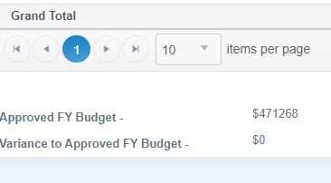
First Things First---How Much is Budgeted?
In the Beginning Budget your amount will be auto filled
Your hospital and amount
0.1% of patient revenue is the maximum allowance

Slide 22
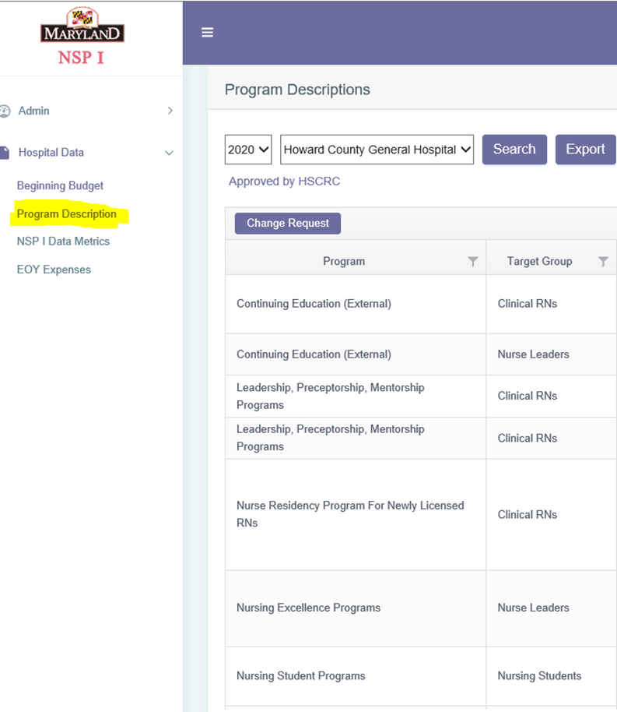
Program Definitions and Planning
Once the amount is identified, programs can be planned in accordance with the NSP I Categories program Definitions and your budget.

Slide 23
Planning Process
Involve your CNO in planning & CFO in budget review and sign off
Grant funds must align with aims and goals of the NSP I program
Funds may be reallocated within the grant program during the year
Approval from HSCRC staff is needed to redirect funds to a new initiative

Slide 24
Examples of Expense Changes
Change that does not need approval:
You determine that in addition to holding preceptor workshops, you need to send another nurse manager to the Nurse Leadership Academy. You have dollars for both initiatives and decide that sending the manager is a high priority. Report that the funds were shifted to this category in the end of the year expenses—no approval needed.
Change that needs approval from the HSCRC:
You have hired fewer grads than anticipated but want to start a summer student nurse extern program in June. You have money to redirect to this program. You then submit a program Change for to the HSCRC staff.

Slide 25
NSP I Categories: (1) Lifelong Learning Programs
Nurse Residency program for Newly Licensed RNs (NLRN)
Transition to Specialty Practice programs for NL and Experience RNs
Academic Nursing Programs:
RN Advanced Degree Programs
Nursing Student Programs
Continuing Education:
Internal
External
Professional Certification

Slide 26
NSP I Categories: (2) Leadership
Transition to New Nursing Leadership Roles
Professional Advancement Programs
Leadership, Preceptorship, Mentorship Programs

Slide 27
NSP I Categories: (3) Advancing Practice of Nurses
Nursing Excellence Programs
Shared Governance
Projects to build nursing science

Slide 28
Programs Inconsistent with NSP I Goals WILL NOT be Approved
Examples of inappropriate use of NSP I funds include:
New position---admission nurse
New position---safety nurse
CPR programs for staff
High school mentorship programs
Celebrations, parties

Slide 29
Program Description
Log into the on-line NSP I tool
Select: “Program Description” to enter specific programs into the template
Program categories are consistent with the overall goals of NSP I
“Program Description” and “Anticipated Outcome (s)” are free text fields

Slide 30
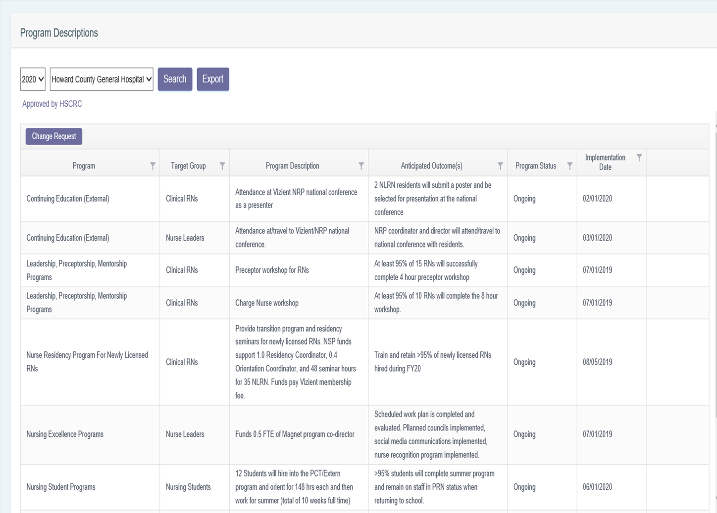
Program Description

Slide 31
SMART Goals
Use the SMART goal format when writing the program description and measures of success:

Slide 32
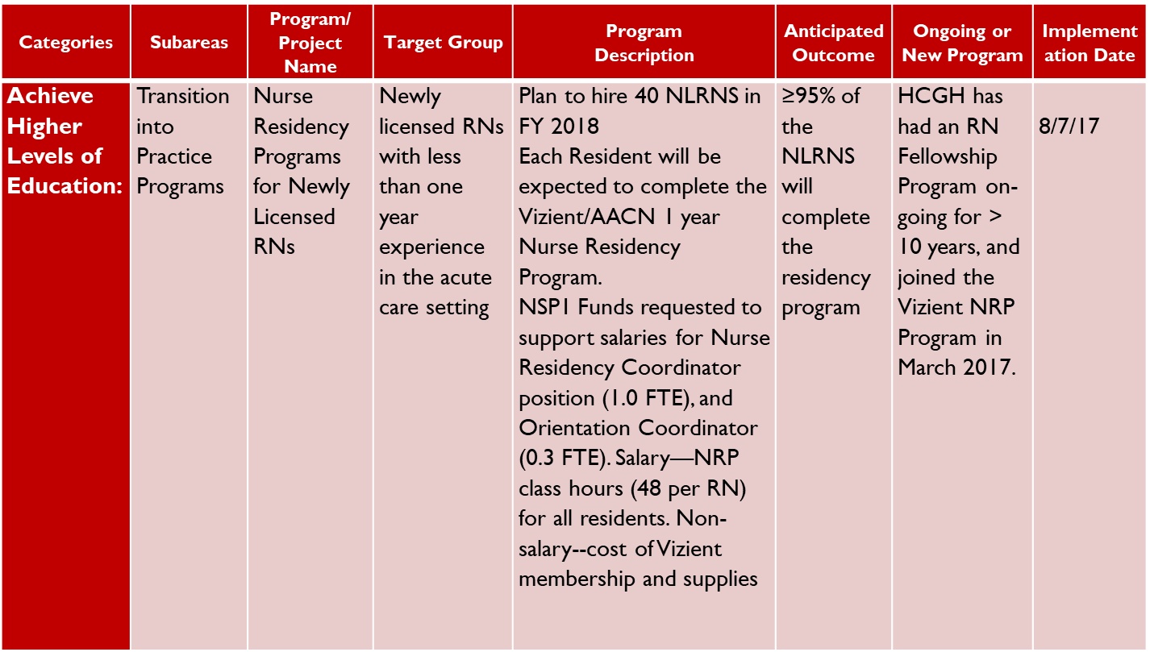
Example---Nurse Residency Program

Slide 33
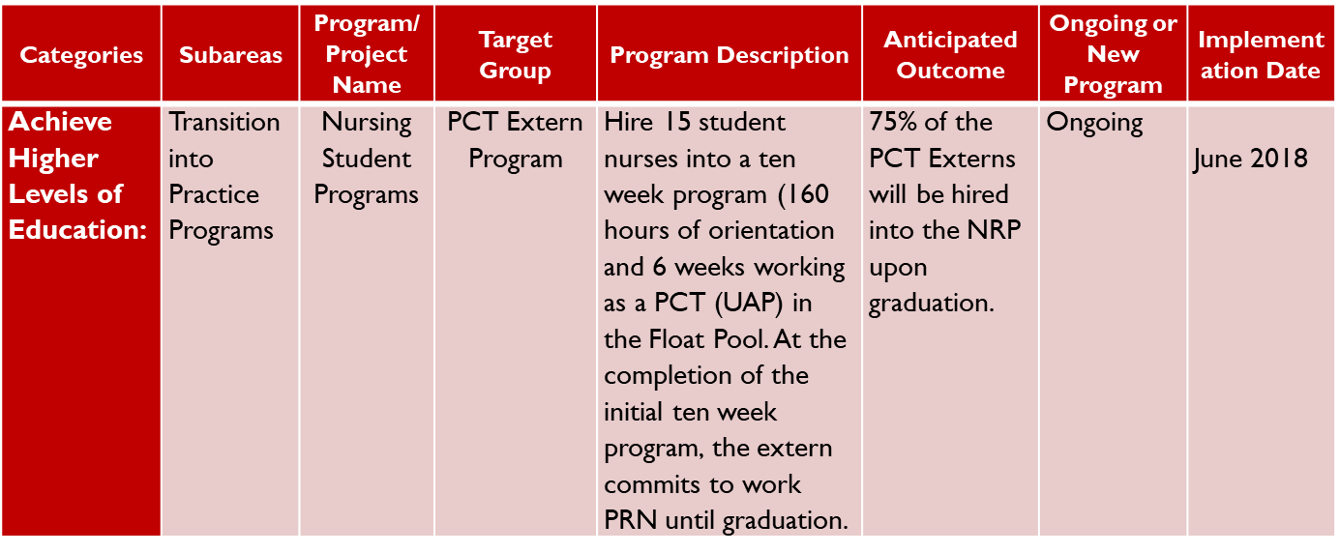
Example---Nursing Student Program

Slide 34
Measures of Success (Outcomes)
We cannot improve what we cannot measure
Identifying measures of success let us know if the change made a positive difference
Annual report requires:
Program-specific outcome measures
A process in facility to collect required data points

Slide 35
Clarifying Terms When Measuring Results
Quantitative Data (Defines)
Quantity, amount, range
Concrete attribute
Amenable to arithmetic or statistical manipulation
Qualitative Data (Describes)
Narrative description of observations
Intangible attributes
Analyze using interpretation

Slide 36
Measurement Plan

Slide 37
Always Think About the Data
Data is required or annual report in addition to program-specific outcomes
Gain familiarity with requirements and establish a measurement plan early in the fiscal year
Expenditures in year-end budget report must match the expenditures reported in the annual program report
Caution!---some of the data for RNs is in FTEs and some is in “bodies”---review the questions closely!

Slide 38
FTEs--Definition
Standard FTE definition for HSCRC:
Full Time Equivalent
Equal to a nurse working 80 hrs. per PP x 26 PP= 2080 hrs. annually (1.0 FTE)
Ex: Nurses who work 3 12-hour shifts weekly are 0.9 FTE
For program description:
FTE calculations are made only for anyone who has a salary supported by the grant
Do not calculate FTEs for the number of nurse residents, or nurses in training programs

Slide 39
Reporting Overview
Data collection tool/guidelines:
On-line
Reporting categories
Finance has a role in supporting the report
HR has a role in supporting the report
Educational meeting on reporting to be held

Slide 40
Annual Report---Data Metrics
On-line tool
Open the tool and select ‘export’ to create a document that will be a worksheet and can be distributed to others

Slide 41
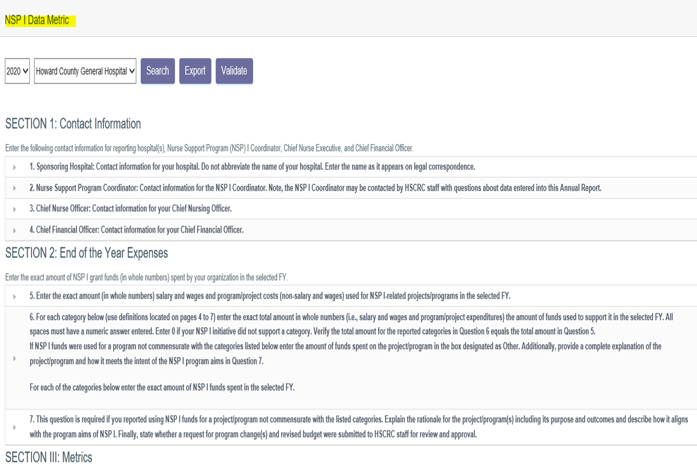
NSP I Data Metrics

Slide 42
Data Collection Tool---Bodies or FTEs?
EXAMPLE: Section III: Program/Project Metrics
For this section, if you are asked to enter the “Number of RNs,” enter the actual number of bodies.
Do not enter numbers using full time equivalents (FTEs) unless specifically directed

Slide 43
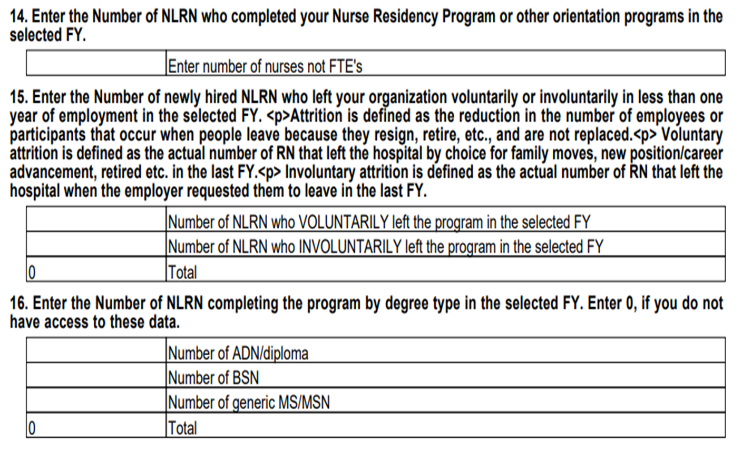
Category: Nurse Residency Program

Slide 44
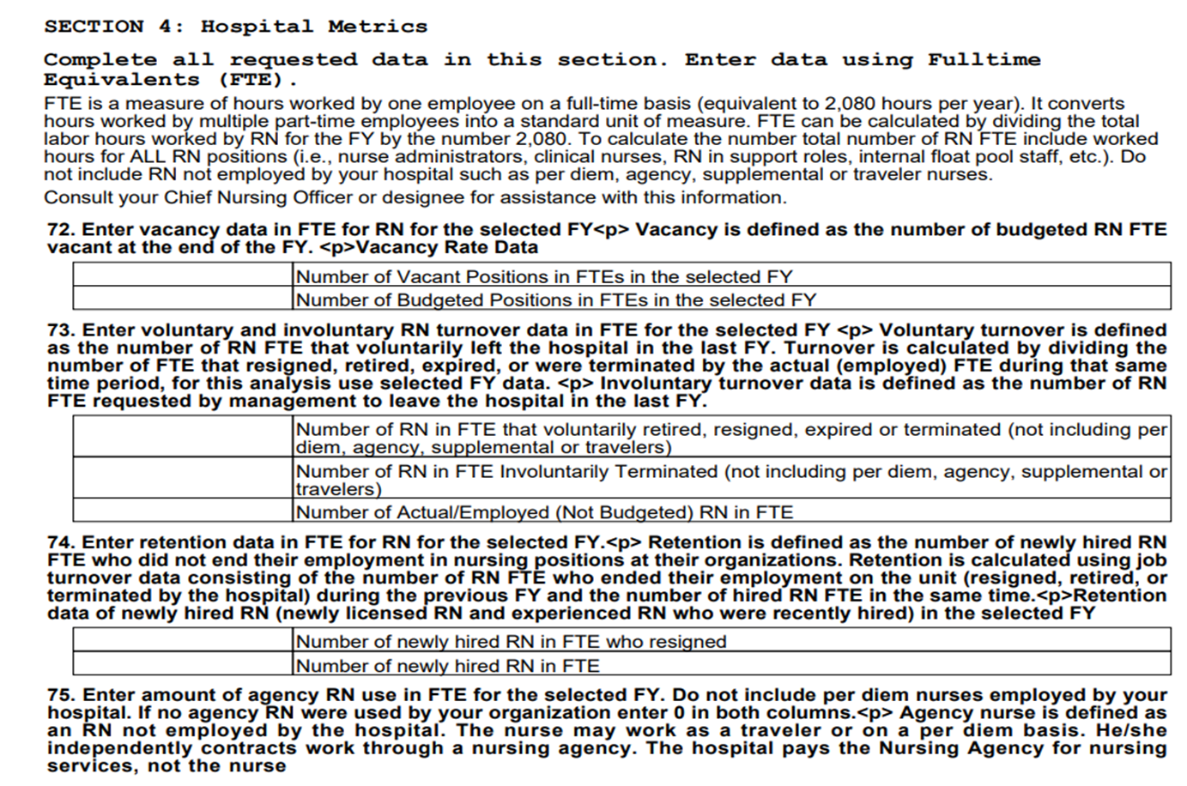
Data Collection Tool---Bodies or FTEs?

Slide 45
Approval Process
Budgets and program descriptions are due on
Programs must meet the aims and goals of the grant to give hospitals discretion in spending, but programs that are part of hospital operations will not be approved
Program requests are reviewed by the Advisory Board and recommended for approval
The Advisory Board may request clarification as needed
Final approval by the HSCRC completed on
Rate requests are submitted to the Commission

Slide 46
Resource Team
Advisory Board Members
Serve as resources for assigned group of hospitals
Contact information is distributed
HSCRC Staff
Oscar Ibarra
Benjamin Quintanilla
Claudine Williams

Slide 47
QUESTIONS

Slide 48
Budget & Financial Submission Benjamin Quintanilla, HSCRC

Slide 49
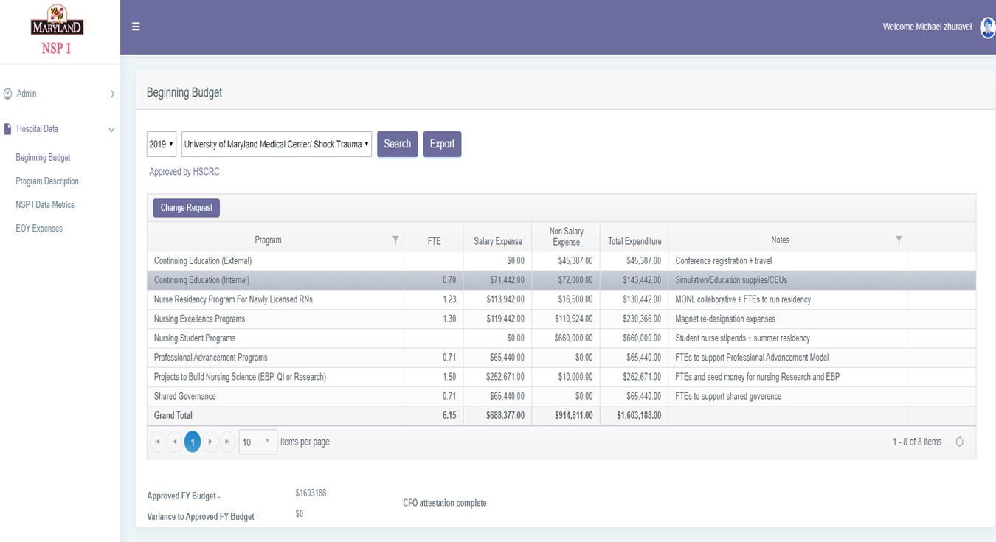
Beginning Budget Submission

Slide 50
Purpose of the Budget Form
To report projected NSP I spending for a given fiscal year
Funds are determined as 0.1% of total patient revenue
Exact amounts are sent by HSCRC
Only NSP I funds should be reported. DO NOT REPORT additional hospital contributions
Budget cannot exceed allocated funds (Online program will not allow budget to be closed out)
Funds must be used to benefit Nursing (including Advance Practice Nursing)
Program Categories are HSCRC approved venues
Any additional category should be approved by HSCRC prior to submission
Common exclusions:
Food & Drinks
Executive Salaries
Online Submission via NSP data collection tool
Deadline for submission is determined by HSCRC

Slide 51
Definitions
Program Category
Description of funds usage
Full Time Equivalents
Hours worked by employee(s) funded by NSPI
If the program supports multiple employees such as residency program, FTE reporting is not necessary
Salary, Wage & Fringe Benefits Expense
Employee salaries for the reporting period
20% should be allocated as fringe benefits in addition to salaries
Non-Salary Program Expense
Any non payroll expense such as educational material
Any changes to the budget after submission require a change submission to be filed for review and approval by HSCRC prior to implementation

Slide 52
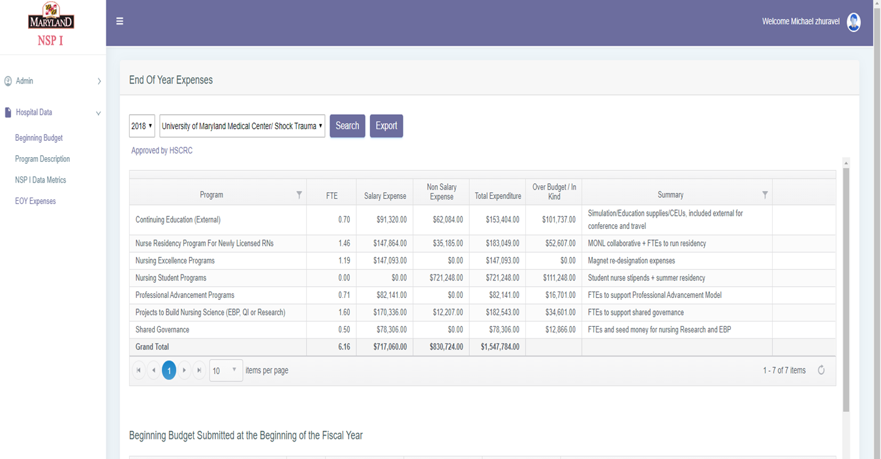
Year-End Submission

Slide 53
Purpose of the Year-End Submission
To report actual NSP I spending for a given fiscal year
Approved Budget should mirror Beginning Budget Submission Form
New change Program description form will automatically pre-fill description block on the Beginning Budget and EOY form.
Actual Program Costs
Facilities can include additional hospital contributions, but are NOT required
All NSP I allocated funds must be accounted
CFO must attest to the accuracy of the document via online tool

Slide 54
Definitions
Program Category
Description of funds usage
Full Time Equivalents
Hours worked by employee(s) funded by NSPI
If the program supports multiple employees such as residency program, FTE reporting is not necessary
Salary, Wage & Fringe Benefits Expense
Employee salaries for the reporting period
20% should be allocated as fringe benefits in addition to salaries
Non-Salary Program Expense
Any non payroll expense such as educational material

Slide 55
QUESTIONS

Slide 56
Recap & Next Steps Oscar Ibarra, HSCRC

Slide 57
Timeline for Annual Reporting FY 20
March 19, 2021
Budgets and Program Descriptions due to HSCRC
March 26, 2021
Advisory Committee convenes to review program descriptions
April 2, 2021
HSCRC emails approvals/ requests for revisions to hospitals
Schedule 1:1 meetings if necessary
May 14, 2021
Revisions to budget and Program Descriptions due to HSCRC
June 11, 2021
HSCRC sends approvals to revisions

Slide 58
Timeline for Annual Reporting
Mid-September
2020
HSCRC convenes
NSP I Coordinators Meeting
NSP I Coordinators start working
on annual Data Collection tool,
EOY expenses and EOY Program Description
Annual Data, EOY Expenses and EOY
Program Descriptions report due to HSCRC
Draft Annual Report
September 18-October 19
2020
November 23
2020
January 2021

Slide 59
New for 2020
EOY Summary for Program Description
Currently this is not required
Similar to initial program description
Will allow for coordinator to indicate whether their goals were met or not met
Will enter description of how goals were met or not met
Data Metrics tool
New demographics section added to data metrics tool
COVID Budget Adjustment
Allows unused funds from FY 20 to be carried over to FY 21

Slide 60
What if I need HELP?????!!!!
Contact the Technical Assistant assigned to your hospital
Contact Ben, Oscar or Claudine
Oscar Ibarra: Oscar.Ibarra@Maryland.gov
Benjamin Quintanilla:
Benjamin.quintanilla@Maryland.gov
Claudine Williams: Claudine.Williams@Maryland.gov
Contact other NSP I coordinators

