Slide 1
Nurse Support Program II: A New Era (2015-2020)
Peg Daw, MHEC
Oscar Ibarra, HSCRC
Priscilla Moore, MHEC

Slide 2
Agenda
10:00 AM Welcome and Introductions- Oscar Ibarra & Peg Daw
10:15 AM NSP II- A New Era- Peg Daw
10:30 AM New Opportunities & Reporting Requirements- Priscilla Moore
10:45 AM Jane Kirschling- Maryland Action Coalition
11:00 AM Patricia Franklin- Leadership Consortium for Academic and Clinical Practice
11:15 AM Lisa Seldomridge and Tina Reid- ES-Faculty Academy and Mentoring Initiative
11:30 AM Jeffrey Willey- ES-WS Faculty Initiative- Needs Assessment
11:45 AM Judith Blum- Inter-professional Education
12:00 Noon Networking Lunch- Table Discussions
12:30 PM Hayley Mark- Supporting Professional Advancement in Nursing (SPAN)
12:45 PM Debra Webster- Faculty Toolkit for Psych-MH Nursing Education
1:00 PM Tracey Murray- Operation Success Initiative Program ( OSIP)
1:15 PM Cheryl Nelson- Nurse Managed Wellness Clinics in Western Maryland
1:30 PM Karen Wons- Associate to Bachelor Nursing Degrees (ATB)
1:45 PM Sabita Persaud- Undergraduate and RN-BSN Programs
2:00 PM Lisa Seldomridge-Increasing access to doctoral education
2:15 PM Judith Feustle- Experiences with shared hospital Simulation and CNE
2:30 PM Louise Jenkins-Carol O’Neil- Susan Bindon- Faculty Development

Slide 3
Health Services Cost Review Commission
Hospital rate regulation in Maryland was established by an act of the Maryland legislature in 1971. The law created the Health Services Cost Review Commission (HSCRC), an independent State agency with seven Commissioners appointed by the Governor.
The law was strongly supported by the hospital industry. The HSCRC was authorized to establish hospital rates to promote cost containment, access to care, equity, financial stability and hospital accountability for quality of care.
The HSCRC has set rates for all payers, including Medicare and Medicaid, since 1977.
Maryland remains the only state to retain such a system.
HSCRC provides funds for NSP I and NSP II

Slide 4
HSCRC and CMS Agreement
Modernization of the All Payer Waiver
This model will require Maryland to generate $330 million in Medicare savings over a five year performance period.
Goals and Timelines for hospital performance
Quality improvements, including reductions in Maryland hospitals’ 30-day hospital readmissions rate and hospital acquired conditions rate will decrease 30% over 5 yrs. Maryland will limit all-payer per capita hospital growth, including inpatient and outpatient care, to 3.58 percent.
Importance of Nurses to Successful Outcomes
RNs + Quality + Safety= Better Care & Health @ Lower Cost

Slide 5
Maryland Higher Education Commission
MHEC is the State of Maryland's higher education coordinating board responsible for establishing statewide policies for Maryland public and private colleges and universities and for-profit career schools.
MHEC Administers the Nurse Support Program II through the Office of Outreach & Grants Management
Responsible for: NSP II – Goals/ Deliverables
NSP II Request for Applications- FON Goals (2011- 2020)
Grant Processes & Funds Disbursement
Program Oversight & NSP II Evaluation (2014-15)
NSP II original 10 yrs. grant evaluation/close out
NSP II initiation of next 5 yrs. renewal period
Faculty scholarships, grants & fellowships

Slide 6
The Joint Commission- 2015
“In an integrated patient safety system, staff and leaders work together to eliminate complacency, promote collective mindfulness, treat each other with respect and compassion, and learn from their patient safety events, including close calls and other system failures that have not yet led to patient harm.” – The Joint Commission 2015 Comprehensive Accreditation Manual for Hospitals The Patient Safety Systems Chapter
Notes:
If patient safety was not yet a strategic imperative within the healthcare industry, it certainly became so when The Joint Commission included “The Patient Safety Systems Chapter” in its 2015 Comprehensive Accreditation Manual for Hospitals. Although the chapter does not include new accreditation requirements, The Joint Commission’s mandate to improve patient safety is clear; based on the guiding principle of “do no harm,” the new chapter aims to align existing Joint Commission standards to reduce preventable harm, advance quality and safety processes, and encourage and recommend proactive quality and patient safety methods. http://www.synensishealth.com/resources/white-papers/patient-safety-systems-chapter/

Slide 7
HRSA Report on Nursing Workforce
The Future of the Nursing Workforce: National- and State-Level Projections, 2012-2025 (December, 2014)
Nationally- expect 340,000 Excess RNs
16 out of 50 states will experience a shortage
Maryland is one of the 16 states- with an expected shortfall of (-12,100) RNs
Notice the AACN Talking Points- forecasted > shortage
Why was NSP II Funded for 5 more years?
NSP II Evaluation findings & projected RNs needs

Slide 8
Nurse Support since 1986
Hospitals fund each NSP Program
NSP I and NSP II both receive up to 0.1% of the hospital gross patient revenue
Expected funding for NSP II ~~$15 mil/yr.
Program funded for 5 years
FY 2015-2020
Awarded/collected funds released over 1-5 yrs.
Evaluation informs future funding

Slide 9
Role of NSP II
Registered Nursing Workforce Intervention
Multi-pronged approach
Two Targets:
Faculty
Educational Program Capacity
Two Recipients: Institutions and Individuals
Competitive Grants and Statewide Initiatives

Slide 10
Data Requirements
* IOM #8 Recommended “Data Infrastructure”
Now we use the Four Pillars- #4 is “Data”
NSP II’s new Mandatory Data Tables
Student Enrollments and graduates
Faculty Employed- FT and PT
Demographic and geographic detail
Readily available- required by other agencies
Measuring trends in Maryland’s RN Workforce
Data for program evaluation

Slide 11
Purpose of Today’s Meeting
To provide information on the new RFA and change in deadlines for applications for FY 2017
To share a new opportunity- an NSP II continuation grant will be available by invitation only
To discuss faculty focused initiatives- NNFF, NEDG, Leadership and Simulation Consortium
To discuss mandatory dissemination requirements and explore all available opportunities
To network and plan for teams with similar projects to make presentations at next MDAC
To hear from you!!

Slide 12
1. FY 2017 Request for Applications
I. To provide information on the new RFA and change in deadlines for applications for FY 2017
Timeline
Timeline Changes
Form Changes
Carryover: Linked to Performance
Site Visits: Financial Audits
Continuation Grants: Invitation Only

Slide 13
RFA Timeline & Changes
FY 2017 Request for Applications Timeline (RFA, pg. 1)
Released : 10/2/15
Technical Assistance Meeting: 12/11/15
Proposals Due: 1/15/16
Review Panel Process
HSCRC Meeting: 4/13/16
Annual Reports Due: 8/31/16
Timeline Changes
New Proposals Due: January 15, 2016
Annual Reports Due: August 31, 2016
Form Changes
Annual Report Template: Dissemination Section
Annual Report Budget Summary: Actual Expenditures
Carryover Changes: Linked to Performance

Slide 14
RFA Timeline & Changes
Site Visits: Programmatic & Financial Review
Financial Review
Random & Focused
Review Supporting Documentation: Confirm annual and/or final reports reflect an accurate reporting of expenditures
Supporting Documentation Examples
Invoices & Receipts
Payment Vouchers
Statements & Cancelled Checks
Payroll Records & Employment Contracts
Contract & Sub-award Documents
( Appendix B)

Slide 15
2. Continuation Grant Option
II. To share a new opportunity- an NSP II continuation grant will be available by invitation only
Continuation Grant: Invitation Only (RFA,pg. 11)
MHEC Invitations Due: December 15, 2015
Rationale: Continuation of funded projects with successful outcomes, including recognition through publications, with clear potential for expansion and statewide impact.
Priority: Projects that are innovative, focus on the future of nursing, and have a regional or statewide impact.

Slide 16
3. Faculty Focused Initiatives
New Nurse Faculty Fellowships- Due 8/31/15
Nurse Educator Doctoral Grants for Practice and Dissertation Research- Due 9/30/15
Hal and Jo Cohen Graduate Nurse Faculty Scholarship- No LEG
New Programs – By Nomination Deans/Directors/CNOs
Leadership Consortium for Academic and Clinical Practice
Due: 8/31/15
Clinical Simulation Resource Consortium
Due:11/30/15
Rationale: NSP II Workgroup recognized the embedded concepts of leadership, inter-professional education and clinical simulation within the FON (2010) report

Slide 17
4. Dissemination of NSP II Work
Discuss mandatory dissemination requirements and explore all available opportunities
Written Reports now due 8/31/16
Rationale: To share successes and lessons learned with colleagues. To move more quickly towards achieving NSP II goals.

Slide 18
Why Disseminate
It is our professional responsibility to disseminate knowledge.
Essential III – Clinical Scholarship and Analytic Methods for EBP states –
We will prepare you to disseminate findings from evidence based practice and research to improve healthcare outcomes (The Essentials for Doctoral Education for Advanced Nursing Practice – AACN, 2006)

Slide 19
Posters
Widely accepted strategy used by nursing and other health professions
Requests for abstracts are sent from conference committees
Abstract are usually blinded and peer reviewed
There will be specific instructions related to the abstract and the poster – if accepted
There are many internet based sites with template formats for the poster
Considerations – fonts size, graphics, flow
Many want to consider handouts
Plan on being present

Slide 20
Podium Presentations
Call for abstract come from committees or you are invited
Abstract are blinded and peer reviewed
Considerations
Type of presentation
Audience
Time Allotment
Setting
Purpose

Slide 21
Publications
Select a topic
Select a journal
Consult author guidelines
You can send a letter of inquiry to the editor
May want to familiarize yourself with EndNote
May want to take a course in writing for publication
Realize your paper will go to peer review
Be prepared to rethink/revise

Slide 22
5. Networking with Presentations
To network and plan for teams with similar projects to make presentations in Maryland at:
MNA conference: Oct. 22-23, 2015
Kathy Ogle, kogle@towson.edu
Deans/Director’s Meetings: Dec. 4, 2015
Betty Webster, ewebster@ccbcmd.edu
MADDN: Mary Kay DeMarco, mdemarco@ccbcmd.edu
MDAC: Jane Kirschling, kirschling@son.umaryland.edu
MONE: Barbara S Jacobs, bjacobsrn@gmail.com
MCCSUN: June 7-8, 2016
Myra Dennis, mgdennis@aacc.edu

Slide 23
Maryland Action Coalition (MDAC)
Let’s hear from Dean Jane Kirschling, UMSON about upcoming opportunities and conferences.
There are opportunities to meet the Future of Nursing recommendations for nursing and NSP II goals, with dissemination through participating with the MDAC.

Slide 24
Maryland Action Coalition Pillars
Pillar 1: Advancing Education Transformation o Nurse Residency – Sherry Perkins (sperkins@aahs.org ) & Joan Warren (joan.warren@medstar.net) o Academic Progression – Linda Cook (cook@son.umaryland.edu) & Laura Polk (laurap@csmd.edu) o Continuing Education – Beth Kilmoyer (bkilmoye@mdmercy.com) & Laura Petri (Laura.Petri@stagnes.org) Pillar 2: Removing Barriers to Practice and Care o Shannon Idzik (idzik@son.umaryland.edu) Pillar 3: Nursing Leadership o Jane Kirschling (kirschling@son.umaryland.edu & Patricia Travis (ptravis2@jhmi.edu) Pillar 4: Data o Rebecca Wiseman (wiseman@son.umaryland.edu)

Slide 25
Leadership Consortium
Let’s hear from Dr. Franklin on the yearlong program that includes nurses from education and clinical practice. https://www.nursing.umaryland.edu/academics/pe/leadership-consortium/
Nominees awarded: September, 2015
Schedule: 10/14/15 Orientation
Weeklong Session: January, 2016
Conclusion: Fall, 2016
To build leadership capacity and
facilitate partnerships between
nursing faculty and clinical
practice leaders for better patient
outcomes and nursing care.

Slide 26
ES-FAMI II
Let’s hear from Dr. Lisa Seldomridge and her team from Salisbury University on their experiences and the continuation grant for NSP II 16-703:
Eastern Shore- Faculty Academy and Mentoring Initiative II

Slide 27
ES-WSFI
Now, Dr. Willey will discuss the:
Eastern Shore-Western Shore Faculty Initiative
Needs assessment ( the group feedback suggested that the survey include in the subject line of the invitation email, “ NSP II Funded Survey” since Faculty are inundated with survey requests- need to set it apart)
Goals and Objectives

Slide 28
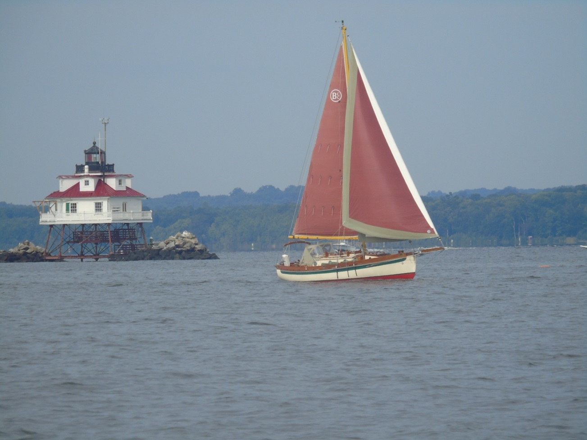
Networking Luncheon

Slide 29
Project Director Participants
Jane Kirschling, University of Maryland
Hayley Mark, Johns Hopkins University
Sabita Persaud, Notre Dame University of MD
Tracey Murray, Coppin State University
Karen Wons, Community College of Baltimore County
Joan Warren, Medstar Franklin Hospital
Maija Anderson, Morgan State University
Judith Blum, Community College of Baltimore County

Slide 30
Project Director Participants
Judith Feustle, Stevenson University
Patricia Franklin, University of Maryland
Louise Jenkins, University of Maryland
Susan Bindon, University of Maryland
Carol O’Neil, University of Maryland
Linda Hickman, University of Maryland

Slide 31
Project Director Participants
Bonnie Fuller, Towson University
Marie Nolan, Johns Hopkins University
Pat Sipes, Howard Community College
James Smith, Coppin State University
Shannon Idzik, University of Maryland
Scott Olden- Baltimore City CC
Pamela Ambush-Burrish- Baltimore City CC

Slide 32
REFERENCES
1. AACN, Talking Points- HRSA Report on Nursing Workforce Projections through 2025, http://www.aacn.nche.edu/media-relations/HRSA-Nursing-Workforce-Projections.pdf
2. The Future of Nursing: Leading Change, Advancing Health, (2010) Institute of Medicine (IOM), http://www.thefutureofnursing.org/IOM-Report
3. Health Services Cost Review Commission, Nurse Support Program I and II, http://www.hscrc.state.md.us/
4. Maryland Higher Education Commission http://www.mhec.state.md.us/grants/nspii/nspii.asp
5. Maryland Regional Action Coalition Recommendation #1 subcommittee needs a member of MCNP, https://maapconline.enpnetwork.com/nurse-practitioner-news/3145-the-maryland-regional-action-coalition-recommendation-1-subcommittee-needs-a-member-of-mcnp
6. Nurse Support Program II www.nursesupport.org
7. U.S. Department of Health and Human Services, Health Resources and Services Administration, National Center for Health Workforce Analysis. The Future of the Nursing Workforce: National- and State-Level Projections, 2012-2025. Rockville, Maryland, 2014. http://bhpr.hrsa.gov/healthworkforce/supplydemand/nursing/workforceprojections/nursingprojections.pdf
8. Wilson, Marissa (2014). Dissemination Presentation, JHUSON ( slides 17-20)

Slide 33
Stay safe- See you again soon!

