Slide 1
Project RUSH Recruit, Unite, Support, Hire: Promoting Entry-level Nurses to PHD Faculty RN PhorwarD (better program name)
Meg Johantgen, PhD, RN
Associate Professor
Associate Dean for the PhD Program
Devan Riley, BSN,RN
DNP Student

Slide 2
Objectives
Increase enrollment in PhD programs through -targeted recruitment -mentoring -research experiences -networking
Identify and engage underrepresented minorities
Provide academic and financial support
Notes:
Conceptualization and methods focused

Slide 3
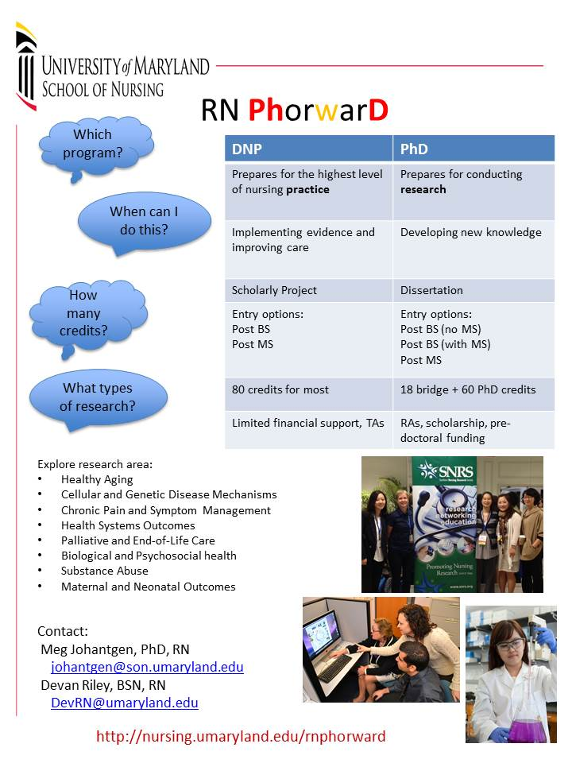
Year 1
Develop marketing materials -Web site -Flyers -Posters
Engage faculty to identify students
Outreach - pizza luncheon information sessions – -all BSN and CNL research classes -Baltimore and Shady Grove
Databases created for interested students and research opportunities
Research experiences -spring - part of BS senior practicum -summer - both paid and unpaid -fall - independent study
Notes:
Conceptualization and methods focused

Slide 4
Lessons Learned
Discussion is largely DNP vs PhD
Curriculums have little “give” in terms of opportunities for research
Students desire some minimal pay (e.g., hourly research assistant)
Winter and summer break may be window of opportunity
DNP students and practicing nurses saw website and expressed interest
Notes:
Conceptualization and methods focused

Slide 5
Year 2
Better integrate research experiences into curriculum
Include BS to DNP students
Expand outreach to other nursing schools -presentations -research experiences
Identify sources of funding for students desiring more intense research experience
Notes:
Conceptualization and methods focused

Slide 6
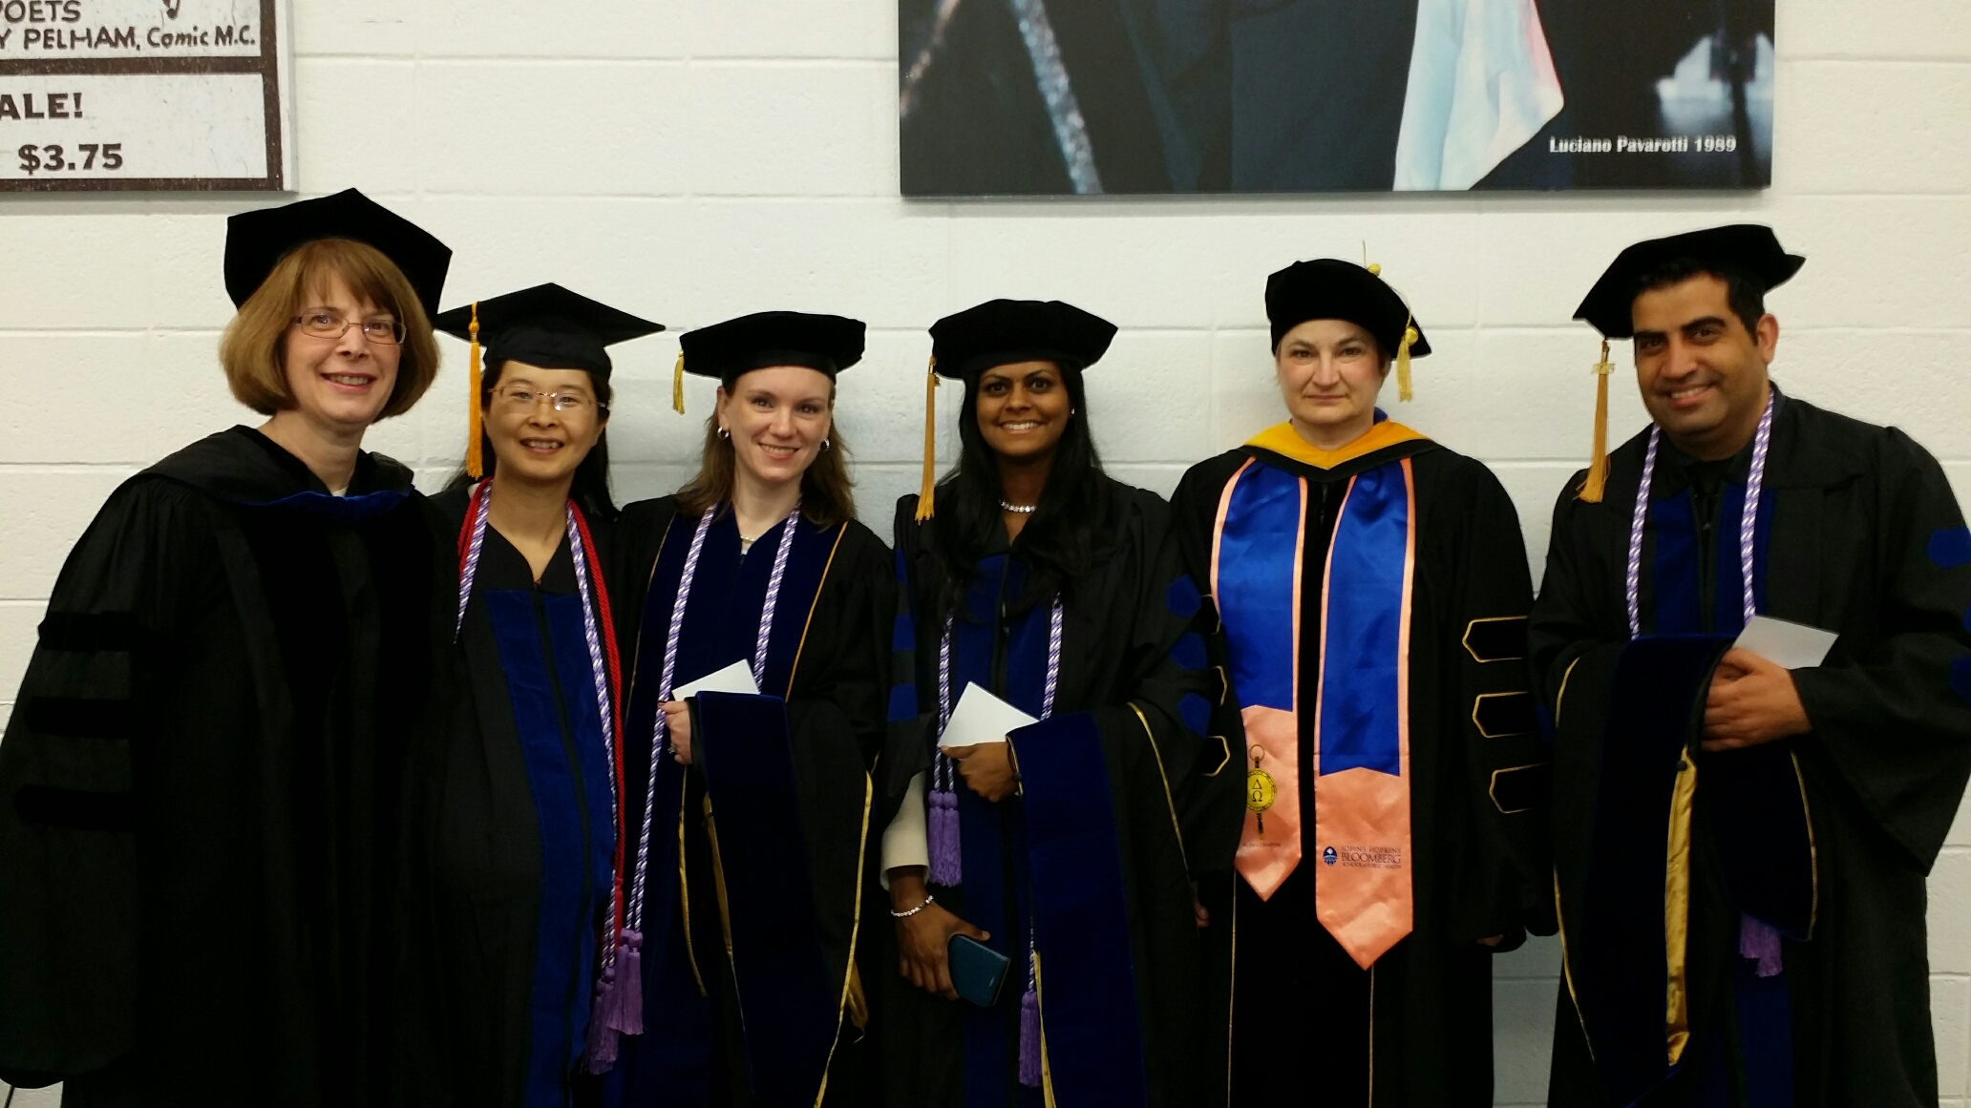
Thank you

