Slide 1
Increasing the Supply of Qualified Nurse Faculty
Hayley Mark, Nancy Hannafin and Nikki Austin

Slide 2
Increasing the Supply of Qualified Nurse Faculty
Goal: To increase the number of qualified full-time and part-time nursing faculty
1) Provide course release and peer support for full-time faculty pursing doctoral degrees with a commitment to teach nursing at a Maryland university
2) Develop and implement a training and mentoring program in partnership with Eastern Shore Faculty Academy and Mentoring Initiative (ES-FAMI) to train part-time faculty prepared to teach nursing didactic and clinical courses

Slide 3
Doctors in progress DIPS
Enrolled, in good standing, in a doctoral program in nursing (PhD, DNP)
Commitment to teach full time at the Towson University Department of Nursing: one year for each year of release time (two courses/year)
Meet quarterly as a group for peer support/mentoring

Slide 4
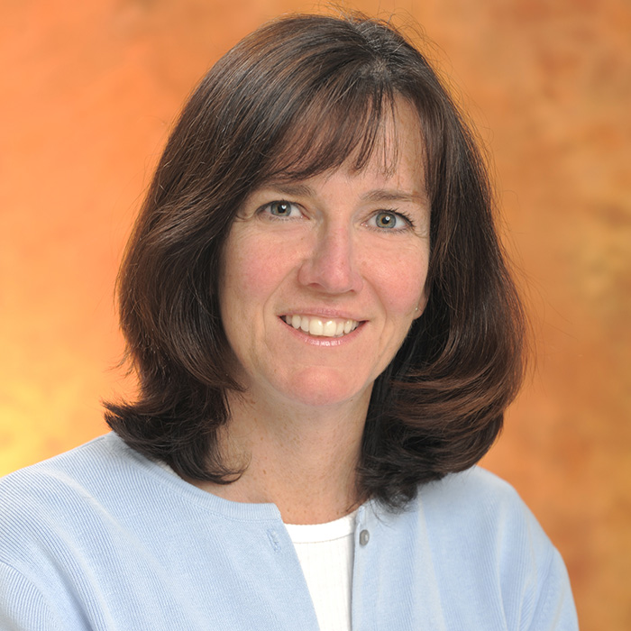
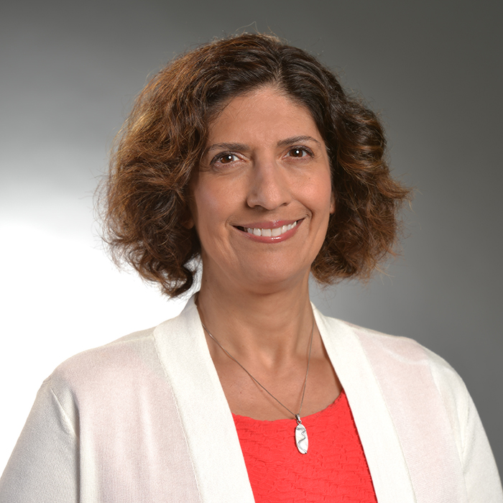
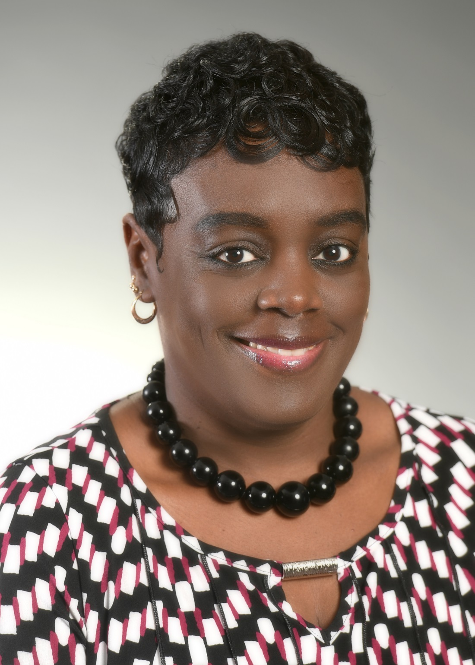
Doctors in progress (DIPS)
Beth Crusse
Nancy Hannafin
Nasreen Bahreman
Renada Gilliard

Slide 5
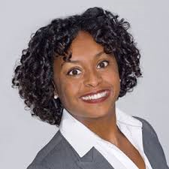
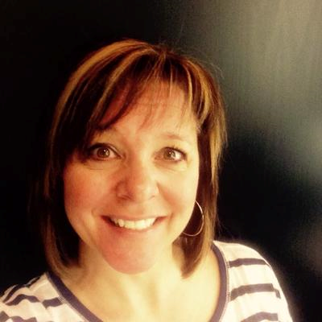
Doctors in progress (DIPS)
Walter Wilson
Marie Statler
Tammy Bowers

Slide 6
DIPS Progress
7 full-time faculty enrolled in doctoral studies and getting one course release per semester
Held two peer/mentoring support meetings
“The Dips program has provided support and collegial networking. I feel incredibly supported with workload release time, peer mentoring and I am not above requesting some tutoring for stats, informatics, and scholarship. Our once a month meetings provide a time to problem solve, decompress and celebrate success.”
“Although a course release is given each semester, the amount of work in the doctoral program far exceeds the time given. However, I have found the coursework rewarding and have already applied some of the concepts to my undergraduate teaching assignments.”
“I thoroughly enjoy our quarterly meetings where we support each other
personally and professionally. We are in different PhD and DNP programs
and follow various research trajectories. One of the best parts is the camaraderie
we have developed between campuses, something that may not have happened
without this group”.

Slide 7
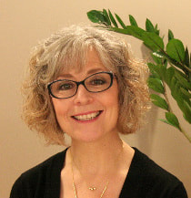
Dr. Laura Taylor
January 25th, 2019 at Towson University
Eight participants (six masters prepared faculty and two masters students)

Slide 8
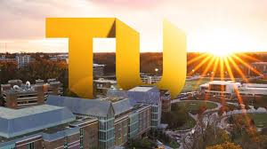
Partnership with ES-FAMI
Form a partnership with ES-FAMI to offer a formal faculty mentoring program to hire and prepare expert clinical nurses educated at the master’s level to teach in the undergraduate baccalaureate program
ES-FAMI has clinical teaching program. Towson is adding didactic teaching component.
July, 2018: TUDON faculty participated in ES-FAMI Academy in Salisbury

Slide 9
Partnership with ES-FAMI
July, 2018: TUDON faculty participated in ES-FAMI Academy at Salisbury
August, 2018: TUDON offers FAMI Academy at Towson
March, 2019: Second TU-FAMI offered at Towson
Summer 2019: Development of didactic portion of Academy complete

