Slide 1
Accelerated Second-Degree BSN
Notre Dame of Maryland University
Nsp II 19-116
NSP-ii Project Director’s Meeting: March 8, 2019
Deborah Naccarini, DNP, RN, CNE

Slide 2
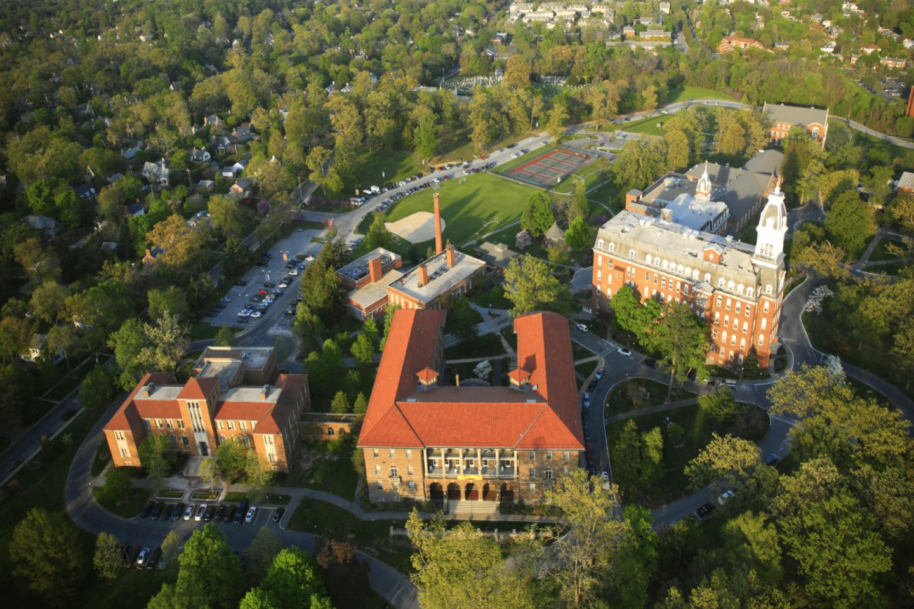
Goals
Overarching Goal: Increase the number of BSN-prepared nurses in Maryland who can care for poor, underserved, and marginalized populations within a framework of caring science.
Deliver an accelerated second-degree BSN (ABSN) in 15 months – June to August.
Increase the overall number of new baccalaureate-prepared nurses in the state of Maryland by 120 by August 2021
Increase MSN applicant pool

Slide 3
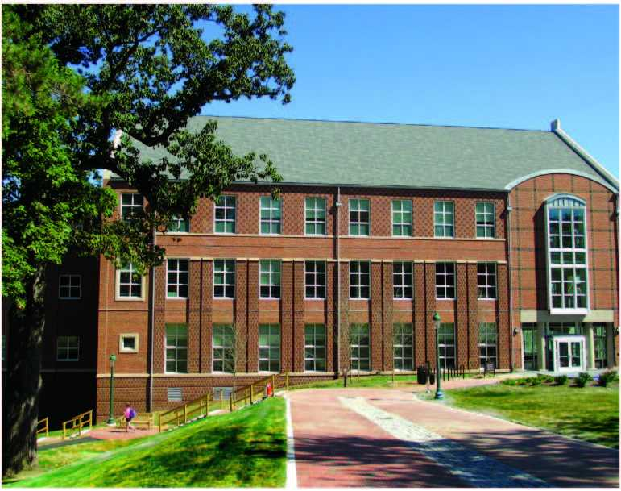
ABSN Program
Requirements
Bachelor’s degree in another field from an accredited college or university
Completion of prerequisite courses with a C grade or better
Statistics, Chemistry, Microbiology, A&P I and II, Genetics and Genomics, Medical Ethics
Science courses <5 years old or relevant employment experience
Minimum cumulative GPA of 3.0
Not required
Essay
TEAS

Slide 4
Marketing
Summer 2018
½ page ad in Baltimore Sun
1 page informational program flyer
Targeted Fb, Google, LinkedIn ad campaign
Press release
Fall 2018
Continued targeted campaigns
Promoted admission events via email, social media, direct mail, and digital ads
NDMU website

Slide 5
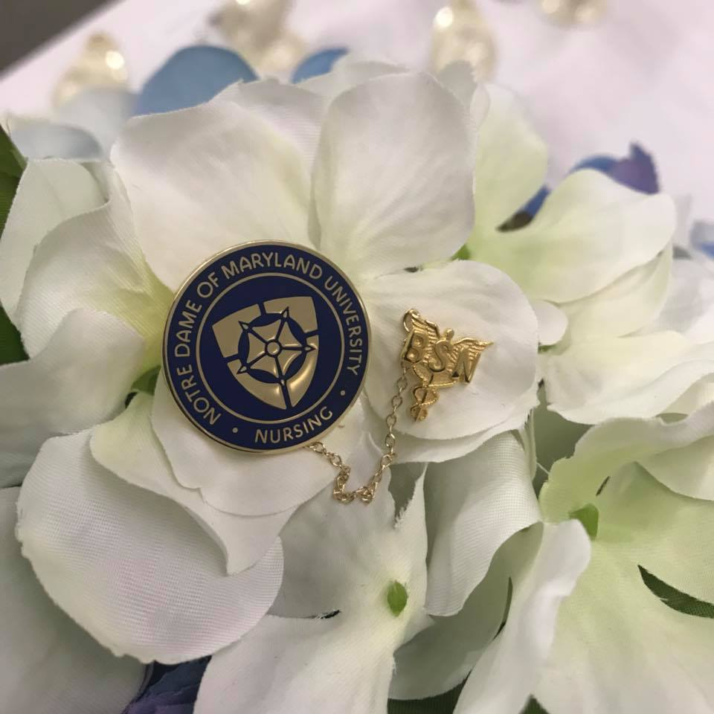
Class of August 2020
424 inquiries since July 2018
74 completed applications
48 students accepted
19 students not ready
7 students not accepted
34 of the 48 accepted students have confirmed attendance

Slide 6
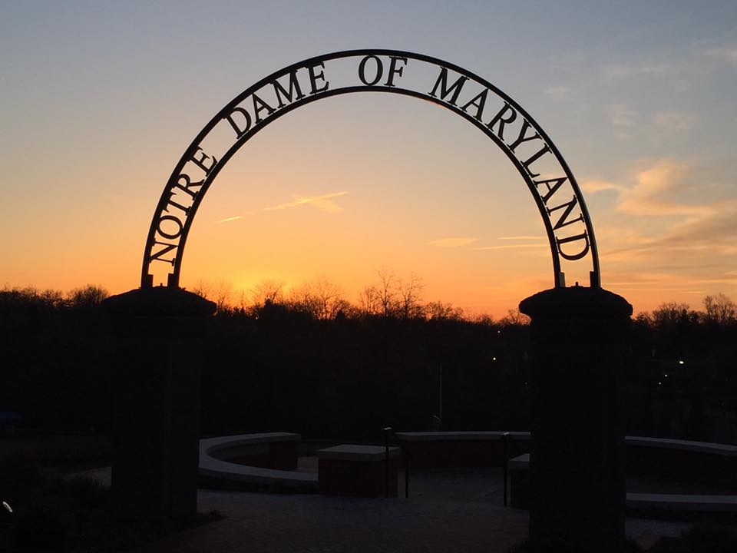
Opportunities and Challenges
Opportunities
ABSN program is under the College of Adult Undergraduate Studies, allowing us to admit men to an Entry-Level program
Demand exceeded expectations
Guaranteed acceptance for qualified students into our MSN program
Challenges
Process for handling inquiries
Application, admission and enrollment processes
Coding students as ABSN
Faculty and staff needs

Slide 7
Next steps
Submit Substantive Change Report to CCNE
Reorganize summer semester courses into 10-week courses
First cohort to start June 3, 2019
Continue marketing plan and begin recruiting for Summer 2020 class
Review admission criteria: TEAS and Essay
Hire one FT faculty for Spring 2020

