Slide 1
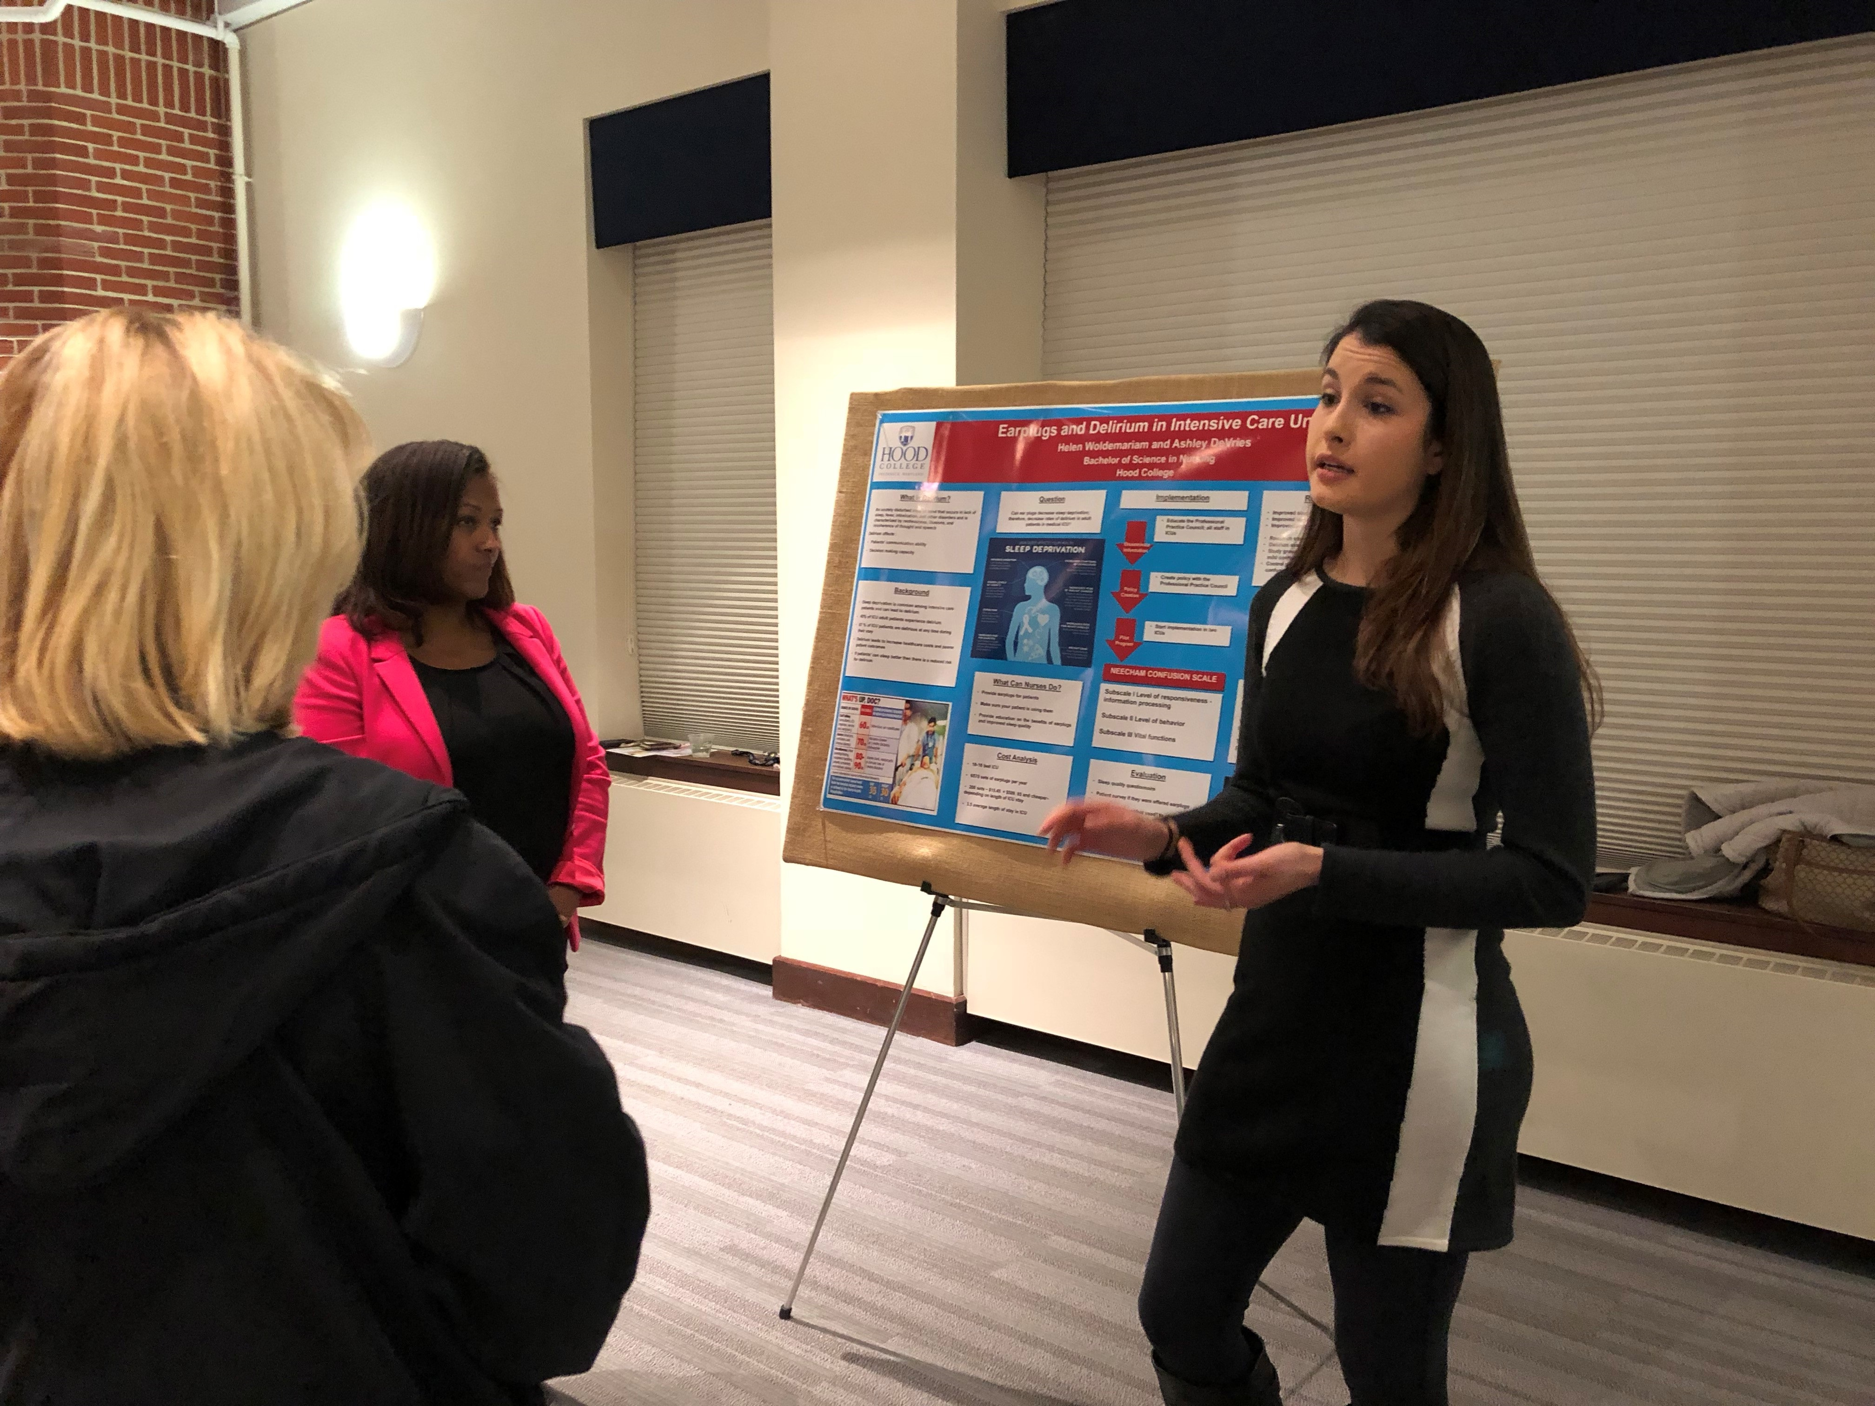
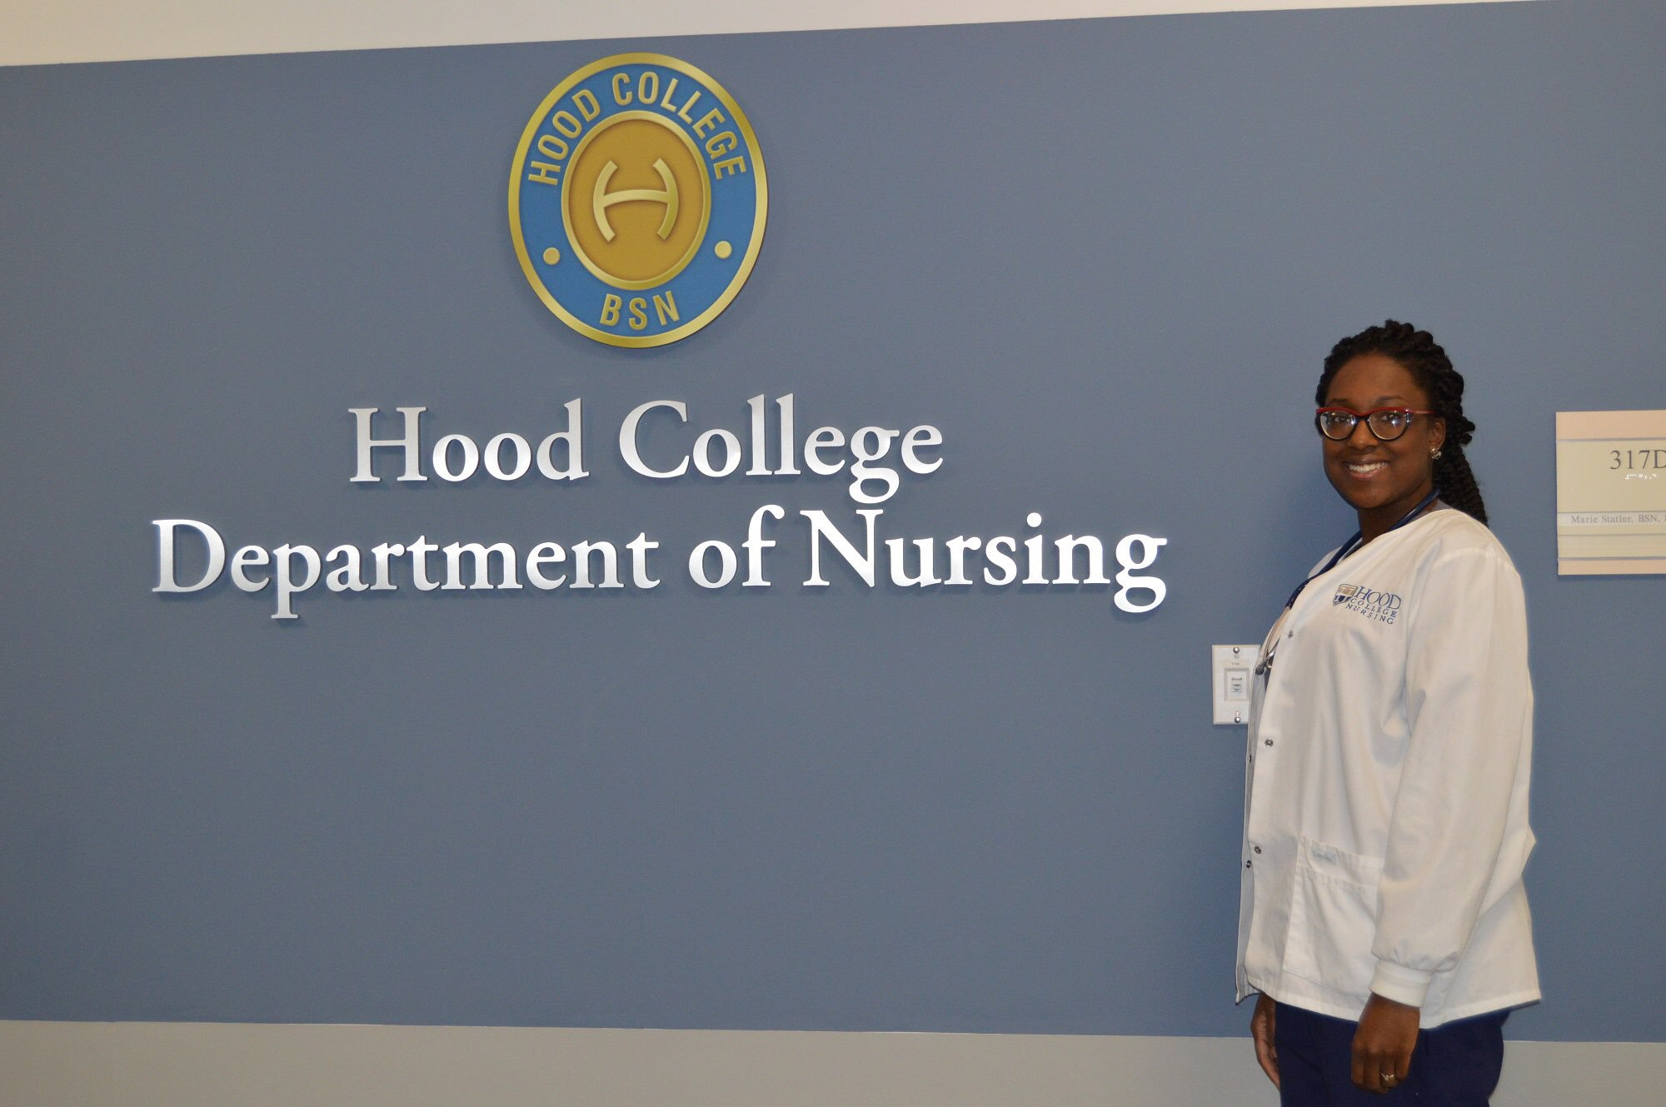
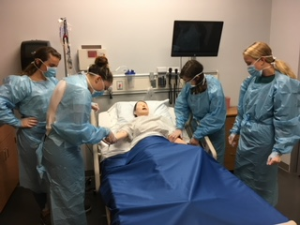
Hood College Nursing
NSP II FY 2017 & 2019
Notes:
We have 2 NSP grants:
NSP II 2017 (5 year): Baccalaureate Nursing at Hood College
NSP II 2019 (3 year): Increasing Capacity for Greater Enrollment in Hood College Nursing Pre-licensure Program
Founding Director, Carol Snapp retired May 2018, Dr. Linda Kennedy hired July 2018
I took over as PD for both NSP II grants

Slide 2
Hood College Pre-licensure Nursing Program Timeline
Past (2014-2018):
2014: 18 candidates enrolled (Freshmen/level 1)
2018: 8 first pre-licensure class graduates
Present AY 2018-2019:
29 students in level 1
25 students in level 2
20 students in level 3
20 students in level 4
Future (2018-2024):
Increase capacity to 50 students;
Graduate 50 pre-licensure students by 2024
Notes:
Note NSP II 2017: Baccalaureate Program at Hood College:
Present: Currently 94 students

Slide 3
NSP II FY 2017 Project Goal & Objectives
Goal: increase the number of nursing students through recruitment and retention of well qualified students, addition of nurse faculty members and hiring a clinical/laboratory supervisor.
1. Graduate nursing students eligible to take the NCLEX-RN.
Add 2 additional faculty members during the 2016-2017 academic year.
Enhance clinical education instruction in the nursing laboratory by spring 2017.
Enhance collaborative efforts with community partners by fall of 2018.
Notes:
Kick-off of our new program—we needed to hire!
Met: 8 graduated and passed NCLEX in 2018.
3 additional hired (others left) for 2016-2017—including me!
Hired lab supervisor Jan 2017 (left in summer 2018; new one hired)
4. Established MOU with FMH to provide Hood with 2 CNS (peds & OB); we “buy out” 10% of their salary or 24 weeks of their time for spring semester.

Slide 4
Notes:
03.22.18 dissemination at U of MD conference

Slide 5
NSP II FY 2019 Project Goal & Objectives
Goal: to increase the number of pre-licensure nursing enrollments and graduates at Hood College.
Hire one full-time faculty member to teach within the program, as well as focus on building education and practice partnerships and articulation agreements with partners, that would result in recruiting more students into the program.
Hire one full-time nursing laboratory and clinical coordinator to coordinate scheduled and open lab sessions and clinical placements.
Hire twelve additional, part-time clinical adjunct instructors to assist with educating our pre-licensure nursing students in the lab and at clinical sites.
Increase the capacity for nursing students through enhanced collaborative efforts with community partners.
Notes:
Outcomes: MORE faculty, staff & instructors to teach, clinical site options, education/practice partnerships and articulation agreements, students admitted, students graduating.
Met: hired Jan 2019
Met: hired summer 2018
Met: 6 new hired this year, 6 more to be hired for fall 2019
4. Previously mentioned FMH partnership with CNS (Peds/OB NSP II FY 2017); intended to be similar model with mental health & leadership; objective not met: Offered to BHU manager in Jan and she turned down; leadership not yet settled, as course has been revised from spring 2018

Slide 6
Projected Growth in Nursing Laboratory Needs
Semester | Courses offered with a weekly lab component | # of students enrolled in course with weekly lab component
Spring 2017 | Adult Health I, Pediatric Nursing, Maternity Nursing | 39
Fall 2017 | Health Assessment, Medication Administration, Fundamentals, Adult Health II, Adult Health III | 104
Spring 2018 | Adult Health I, Pediatric Nursing, Maternity Nursing | 66
Fall 2018 | Health Assessment, Medication Administration, Fundamentals, Adult Health II, Adult Health III | 136
Spring 2019 | Adult Health I, Pediatric Nursing, Maternity Nursing | 82
Notes:
Presented in NSP II FY 19 app

Slide 7
Projected Growth in Clinical Adjunct Needs 2016-2022
Notes:
Presented in NSP II FY 19 app

Slide 8
Hood Partnership with ES-FAMI
Notes:
Not part of our grant, but helps to educate and mentor our Cis
Coming to western MD in May!
Thanks to Tina Reid, Beverly Payne & Brad Hauck at Salisbury

