Slide 1
TOOLKITS FOR NURSING LEADERSHIP DEVELOPMENT MHEC NSP II Project Director’s Meeting
March 8, 2019
NSP II 18-120

Slide 2
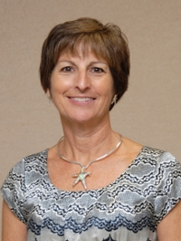
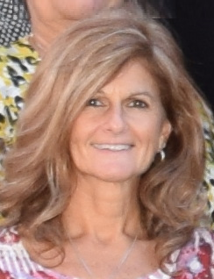
Project
Co-Director’s
Lisa Seldomridge, Ph.D., RN, CNE
Professor of Nursing
Director of Henson Medical Simulation Center
Debra Webster, Ed.D., RN-BC,CNE
Associate Professor of Nursing
Undergraduate Program Chair

Slide 3
Project purpose
Create web-based learning experiences to cultivate better skills in leadership and management in conditions of increasing uncertainty (IOM, 2011)
Target audiences
Undergraduate nursing students
Practicing nurses at partner hospitals

Slide 4
Collaborating Partners

Slide 5
Advocacy
Interprofessional
Collaboration
Conflict Management
What’s in your Toolkit?

Slide 6
Toolkits include:
Learner objectives
Materials for educators
Video vignettes enacted by Standardized Patients (SP’s)
Show effective and ineffective communication
Activities to encourage:
Practice
Critique
Refinement of leadership skills
References

Slide 7
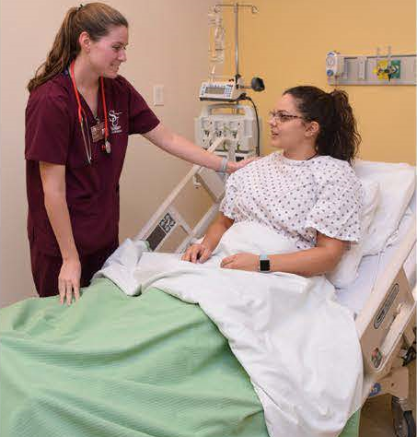
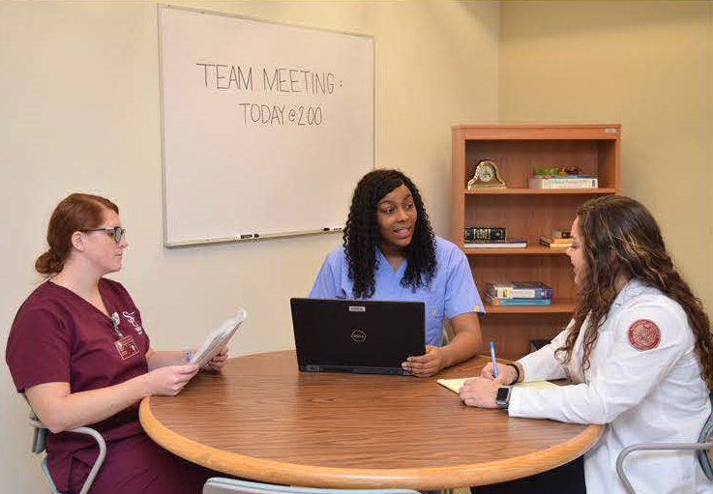
Themes
Interacting with diverse populations
Preparing for interprofessional workplace
Dealing with common behaviors that arise in stressful work environments
Notes:
Types of interactions-Nurse to Patient/Family, Nurse to Nurse or Other Health Professional, Superior to Subordinate

Slide 8
Leadership Toolkits Part 1
Integrated the leadership concepts into existing behavioral health toolkits:
Therapeutic Communication and Professional Boundaries(IPC)
Substance Misuse (Conflict Management)
Currently integrating advocacy into:
Hallucinations and Delusions

Slide 9
Leadership Toolkits Part 2
Develop new toolkits
Interprofessional collaboration (IPC) in EOL decision making
Conflict management in post-op care
Implement with undergraduate nursing students and refine as needed
Share with hospital partners for:
New graduate orientation/residency programs
Onboarding new nurses
Ongoing professional development

Slide 10
Year One Successes-(2017-18):
Developed grant team of toolkit coordinators and subject matter experts
Integrated activities to foster development of leadership skills (collaboration and conflict management) in behavioral health toolkits.
Collaborated with hospital partners to brainstorm scenarios for toolkits on IPC and conflict management in non-psych settings.
Expanded use of toolkits with undergraduate nursing students in behavioral health and leadership courses.

Slide 11
Year Two Successes (2018-19)
Toolkits
Standardized Patients
Script revisions for Interprofessional Collaboration in End of Life scenario
Positive feedback about IPC toolkit from faculty and students
Decision to introduce students to IPC earlier in curriculum
Dissemination
MHEC NSP II Project Director’s Meetings
MNA Conference
STTI Lambda Eta Chapter Substance Use Disorders Conference
Upcoming presentations
Recruitment and training of new actors including healthcare professionals
Use experienced actors to assist with training new actors
Ongoing coaching of all actors
Standardization of experiences for faculty and students

Slide 12
Challenges
Designing scenarios that are appropriate for different learner groups (students and RNs)
Grant personnel changes
Integration of SPEs into a course that had not previously used this type of simulation
Adoption of a consistent debriefing model
Updating toolkit website while the university overhauled its entire website

Slide 13
https://webapps.salisbury.edu/leadershiptoolkit/
How to Access Toolkits
Behavioral Health
https://webapps.salisbury.edu/psychnursingtoolkit/
Leadership-Non behavioral health

Slide 14
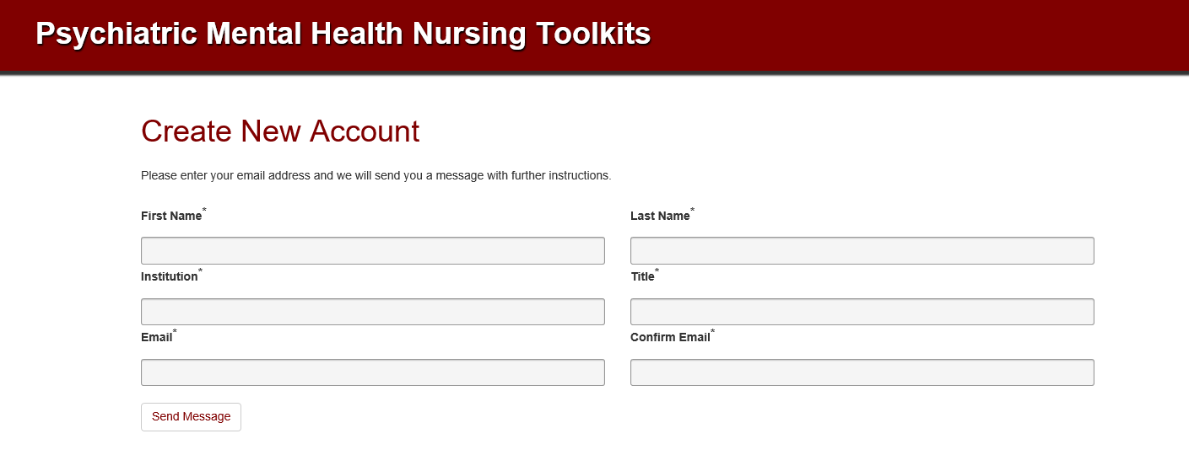
Faculty email address

Slide 16
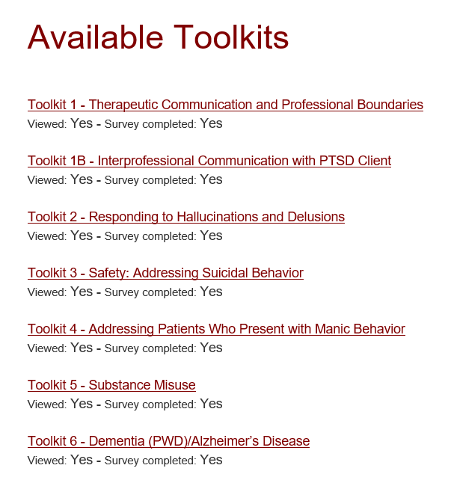

Slide 18
UNDER CONSTRUCTION

Slide 20
REFERENCES:
Institute of Medicine (2011). The Future of Nursing Leading
Change, Advancing Health. Washington (DC): National
Academies Press (US); 2011. Retrieved from:
https://www.ncbi.nlm.nih.gov/books/NBK209880/
Dreifuerst, K. T. (2015, May). Getting started with debriefing for
meaningful learning. Clinical Simulation in Nursing,
11(5), 268-275. http://dx.doi.org/10.1016/j.ecns.2015.01.005.

Slide 21
The growth and development of people…
is the highest calling of leadership.
Harvey S. Firestone

Slide 22
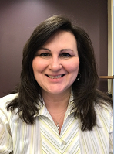
Contact information:
Beverly Payne
Administrative Assistant
MHEC-NSP II NURSING LEADERSHIP TOOLKITS GRANT
Conway Hall, Room 353-D1
1101 Camden Avenue
Salisbury,MD 21801-6860
Phone: (410) 546-2868
Email: bxpayne@Salisbury.edu

