Slide 1
Supporting Professional Advancement in Nursing (SPAN) Program
Johns Hopkins School of Nursing
Sarah Firestone, MSW
SPAN Program Manager
www.nursing.jhu.edu

Slide 2
The Goal
Develop, implement and evaluate an innovative program to seamlessly bridge and advance the transition of students from pre-licensure generalist to graduate professional specialty or doctoral practice.
Transition new graduate nurses into the workplace and keep them there!!
Support new graduate nurses as they pursue their advanced graduate studies so they have all the tools to succeed.

Slide 3
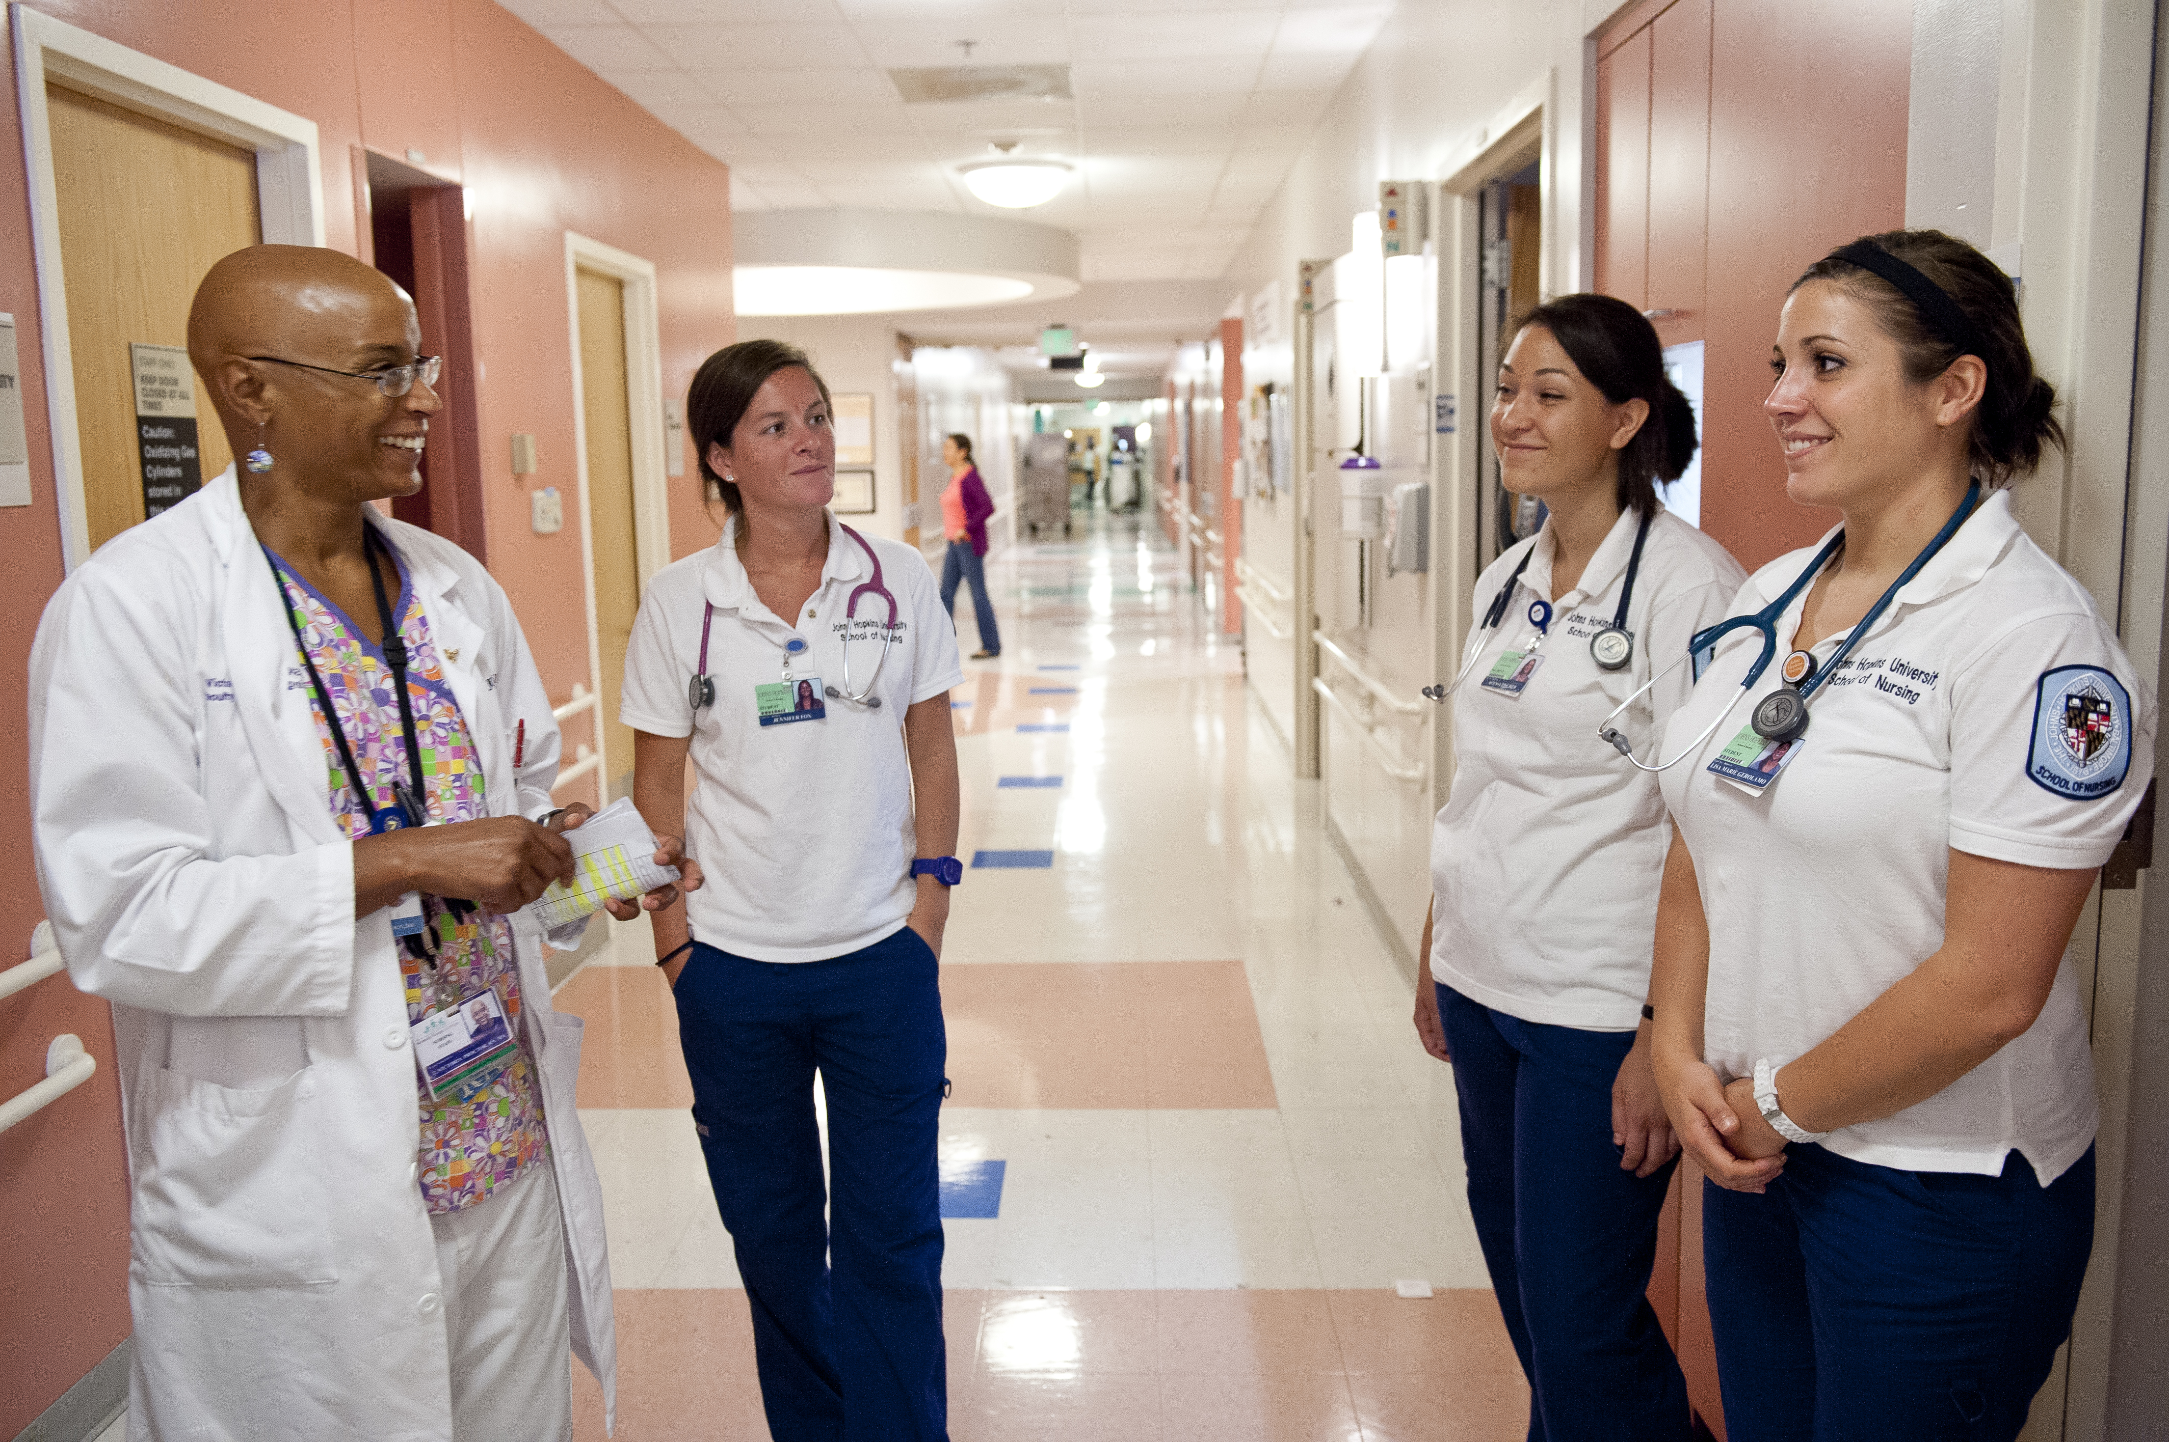
Funded for 5 years - July 1, 2015-June 30, 2020.
Currently in PY 4
Participants move through Program in approx. 4 years
Five Partners
Johns Hopkins Hospital
Johns Hopkins Bayview Medical Center
The Baltimore VA Medical Center
Sibley Memorial Hospital
Mt. Washington Pediatric Hospital

Slide 4
Three Phases of SPAN Program
Synthesis Practicum
14 week experience leading to full-time RN employment in practicum facility
Phase 2-Explore Specialty Role
Mentoring by JHSON faculty, facility mentor(s), online and in-person tools and support, apply to advanced specialty degree program, all while continuing to work full time in practicum facility
Phase 3- Generalist to Specialist
Enrollment in a advanced graduate program while continuing to work at the practicum facility. Cont. to receive access to mentorship and program supports.
Phase 1- Generalist Role

Slide 5
Win-Win for Maryland and SPAN Participants
Maryland
SPAN Participants
Address nursing workforce shortage:
Nurses with advanced training to MD workforce.
MD hospital staffing - 3 year work commitment
Enhance MD nursing workforce by retaining best and brightest, high performing nurses.
Project forms partnerships with Hospitals who are funders of NSP I/II Program.
Career placement and full time work
Work experience while obtaining advanced nursing degree.
Mentorship—support and guidance beyond graduation.
Toolbox tools for transition to workforce

Slide 6
SPAN Applicants
JHSON pre-licensure students in final semester of nursing school
High Performing! (GPA >3.5, excellent references etc.)
Committed to:
return to grad. school 12-18
mo.
their employer and program for
min. of 3 years.

Slide 7
Participant Data

Slide 8
Participant Data

Slide 9
Participant Data

Slide 10
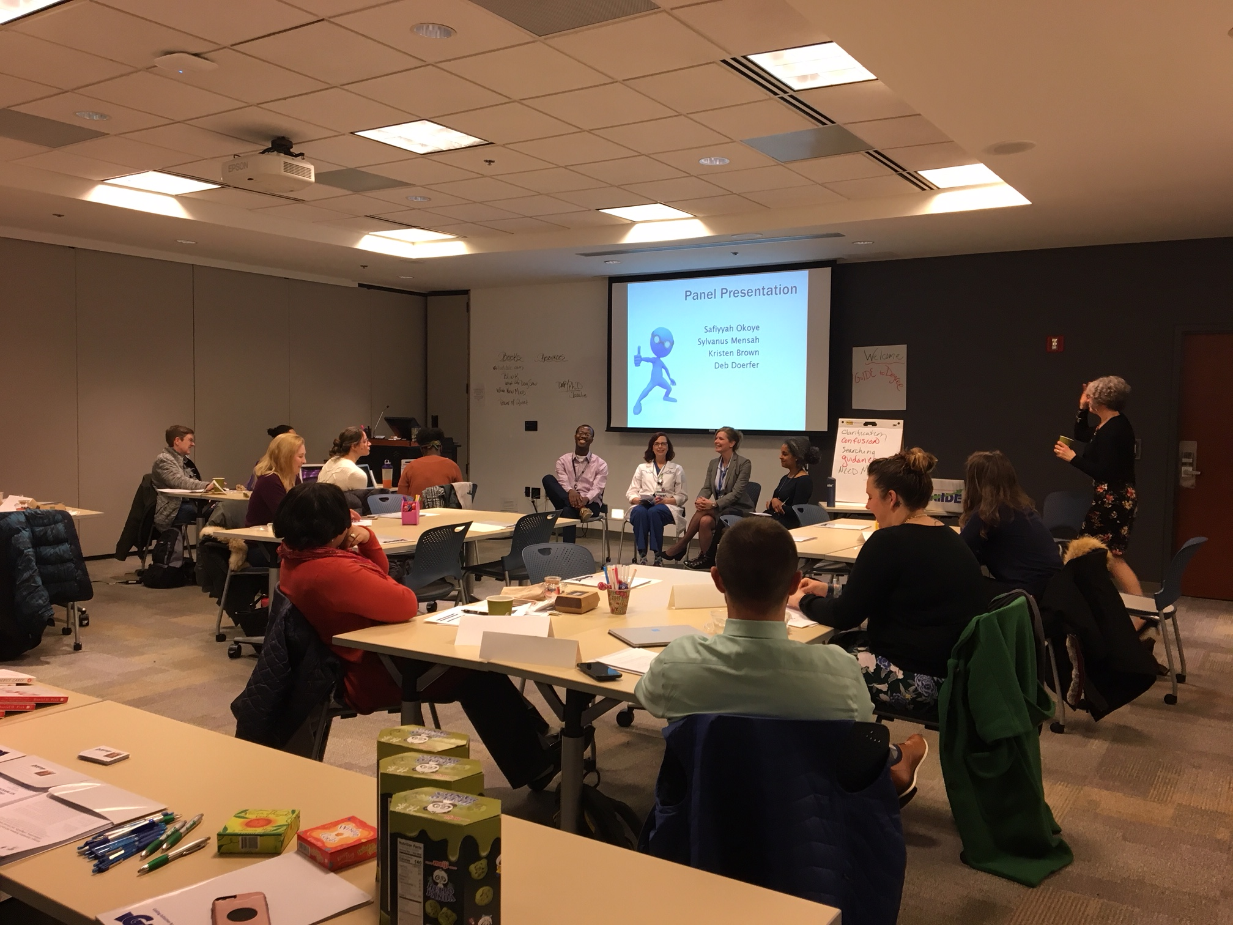
Program Successes/PY 4 updates
Nurse Retention for the State of MD
Partner and Mentor Events
GuIDE to be offered again!
Dissemination/Pacesetting Program Award
Publication being submitted this month!
Collaboration with Towson NSP II funded project
Supporting the new graduate nurse with tools and incentives for success

Slide 11
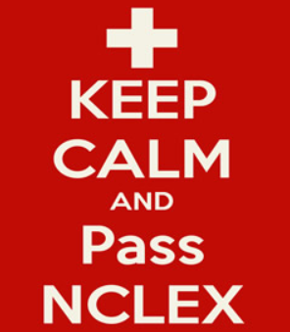
Supporting the New Graduate Nurse
Push Notifications
PATH and Balance Modules
Goal Setting
Professional Development Plan & Portfolio
Bringing it Together
Work-Life Balance
Organization & Time Management
Professional Practice
Quality & Safety
Communication & Conflict Management
Leadership & Advanced Roles
Ethical Decisions
Mentorship,
Faculty and Hospital

Slide 12
What Participants Are Saying
…you all truly care about our future success through reaching out and checking in on us. I truly appreciate this aspect of the program because it shows me that you all are still available and invested in our future as advanced practice nurses. From the modules, to a mentor and even the regular text messages with tips and check-ins is much appreciated and valued.
What was most valuable to me was how the program coordinated parts of the onboarding process with my manager and helped start the conversation regarding me continuing my education while working. I also loved that the program provided me with a NCLEX course to prepare for the exam. I feel supported and always know I can reach out to my mentor whenever I need anything!
SPAN has been there for me as I transitioned from nursing student to labor and delivery nurse to Nurse-Midwifery/Women's Health Nurse Practitioner student. The SPAN program has gifted me with the structure and mentorship to make this transition feel natural. I think the program has made it possible for me to be successful in pursing my career goals. The program has given me the support I needed to pursue my career goals with confidence. SPAN is the program that grows with you and is always there to support and guide you.
One of the biggest benefits that I have gained as a participant of the SPAN program is that the often overwhelming inquiry into choosing the most appropriate advanced practice program is broken down into manageable pieces that are easier to tackle. Most notably, the GuIDE workshop did a good job of providing relevant information and support regarding the doctoral application process, funding opportunities, and ways to strengthen a prospective student's application.

Slide 13
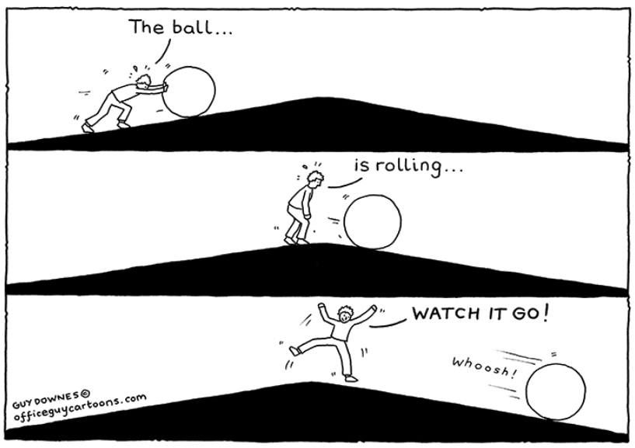
But we have momentum now!

Slide 14
Thank you!
Sarah Firestone, SPAN Program Manager
sschne27@jhu.edu
443-287-6714
The SPAN Program that was the subject of this presentation was produced with the assistance of a Nurse Support II Program grant (grant # 16-112) under the auspices of the Health Services Cost Review Commission. Opinions, findings, and conclusions expressed herein do not necessarily reflect the position or policy of the Health Services Cost Review Commission, and no official endorsement should be inferred.

Slide 15
Leading the way in education, research and practice – locally and globally.

