Slide 1
Let’s take a dive into the data!
Presented by Laura Schenk MS, RN
Academic Progression Coordinator for Nursing at Harford Community College & Cecil College

Slide 2
Objectives
Review project goals and objectives
Analyze data from various activities
Discuss the impact of current data
(“Dive deep,” n.d.)

Slide 3
Recognition of support
Maryland Higher Education Commission’s Nurse Support Program II
NSP II grant # 16-111: “Cecil-Harford Academic Progression in Nursing Initiative”

Slide 4
Starting at the surface
An overview of the project
(“Scuba diver,” 2009)

Slide 5
Project goals
Increase the number of ADN graduates who complete a BSN or MSN through increased opportunities for seamless academic progression by 120 students by 2020.
Create tools and establish systems for collecting accurate baseline data.

Slide 6
Project Objectives
Academic progression coordinator
Dual enrollment partnerships
Articulation agreements
Professional development activities
Website resources
Data collection, analysis, projections

Slide 7
Timeline
Fiscal year 2016 – Fiscal year 2020
Year 1 – Year 3 completed
2 years remain
Year 1: FY16
Year 2: FY17
Year 3: FY18
Year 4: FY19
Year 5: FY20

Slide 8
The center of it all
Achievement of expected outcomes
(Firsta, n.d.)

Slide 9
Dual Enrollment/Dual Admission
Partnerships/articulations
Enrollment
Retention and attrition
Degree completion!

Slide 10
Partnerships/articulations
Increase the number of partners for dual enrollment
Harford Community College:
Towson University ATB Option
Frostburg State University ATB Option
UMSON Dual Admission
Cecil College:
Towson University ATB Option
Frostburg State University ATB Option
UMSON Dual Admission
Increase the number of articulation agreements and MOU’s with BSN/MSN degree institutions by 8, including dual enrollment curriculums
Harford Community College:
Drexel University
Cecil College:
Stevenson University
Wilmington University
George Washington University

Slide 11
Partnerships/Articulations

Slide 12
Enrollment: ATB and Dual Admission
Average % of incoming class that matriculates is 49% at HCC and 16% at CC

Slide 13
Retention/Attrition
For Towson ATB Option
Descriptive statistics for Towson ATB Option | Summer 2016 | Fall 2016 | Spring 2017 | Summer 2017 | Fall 2017 | Spring 2018
Starting enrollment (# of students) | 30 | 61 | 85 | 96 | 136 | 151
Ending enrollment (# of students) | 30 | 57 | 83 | 95 | 135 | 147
Student withdrawals | 0 | 4 | 2 | 1 | 1 | 3
Retention rate | 100% | 93.44% | 97.64% | 98.95% | 99.26% | 97.35%
Attrition rate | 0% | 6.55% | 2.35% | 1.04% | 0.73% | 1.99%

Slide 14
Degree completion
December 2017 = 1 degree completed
May 2018 = 17 degrees completed
39 degrees in progress
+ 95 students dually enrolled
+48 potential new admits
Initial data
Projected outcomes
Expected to surpass our goal at project completion!
Total of 200 projected degrees completed

Slide 15
Exciting finds
Unexpected outcomes
(“Byron Bay,” 2015)

Slide 16
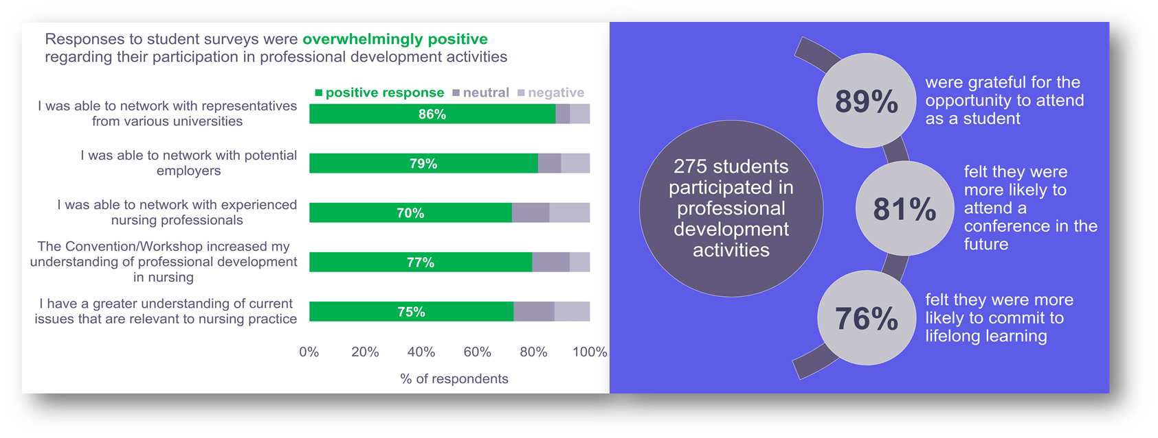
Professional development
Survey data from initial 3 events; total of 146 respondents
Notes:
Students were asked to respond to a survey rating their experiences at the Maryland Nurses Association Convention, Maryland Association of Nursing Students Convention, and the Nursing Student Leadership Workshop (sponsored by NSP II 16-111).
14-15 question survey that utilized multiple choice, five point Likert scale, and included three open-ended questions.
Initial data was supportive.
The desired outcomes related to our grant’s goals were achieved.
This supported the continuation of professional development activities.

Slide 17
Professional development
Survey data from attendance at MNA Convention in 2017; total of 38 respondents.
What actions have you performed as a direct result of networking experiences at the MNA Convention on October 5, 2017? Select all that apply.
Actions | Responses | Frequency
Read about current issues in nursing practice in publications or articles (outside of what is required for school assignments) | 15 | 39.47%
Visited a University’s website to learn more about their nursing programs (RN-BSN, RN-MSN, DNP, PhD, etc.) | 14 | 36.84%
Spoke with a University representative about their nursing program | 12 | 31.58%
Visited a potential employer’s website to learn more about job offerings | 10 | 26.32%
Visited the website of a professional nursing organization (MNA, MANS, etc.) | 10 | 26.32%
Notes:
We are also assessing the behaviors of students as a result of their experience to see if a more concrete correlation might exist.
This is one of the new questions added to the survey.
The actions with the highest number of responses are shown here.
In addition to this…
5 students joined a professional nursing organization (MNA, MANS, etc.)
4 students applied to a degree completion program at a university (RN to BSN, RN to MSN, etc.)
3 students established a mentor who has experience in the nursing profession
2 students received a job offer for a position through a potential employer

Slide 18
Professional development
Survey data from 2nd annual Professional Development Workshop on April 27, 2018; total of 61 respondents.
Prior to attending the workshop today, were you already accepted into an RN-BSN or RN-MSN program to begin after graduation?
Answer choices | Responses | Frequency
Yes | 21 | 34%
No | 40 | 66%
Did you apply to an RN-BSN or RN-MSN program at the workshop today?
Answer choices | Responses | Frequency
Yes | 11 | 18%
No | 50 | 82%

Slide 19
Hidden treasures
Anecdotal reports, qualitative data…
(Gerigk & Hirst, 2017)

Slide 20
The student’s experience
The dually enrolled student:
“It is easier to do ATB because you are getting it out of the way and you don’t have to worry about procrastinating and not going back to school.”
“I think what makes the ATB option successful is that it allows students the option to work towards their BSN at the same time while enrolled for their ADN. I also think what makes this program appealing and successful is that I will be fully prepared to enter the workforce.”
“I like the way the curriculum is panned out allowing for some deviation if necessary, but also keeping you in school year round. It helps to not lose the momentum from semester to semester.”
Takeaways from professional development activities:
“Nursing isn’t about just going in to work and coming home. Continuing your education is also very important and bettering yourself to better our care for patients.” -114th MNA Convention
“It’s up to new nurses to help with attitude, communication, and behavioral modifications to improve culture.” –Professional Development Workshop

Slide 21
Pearls of wisdom
What is the data telling us?
(Dreamstime.com, 2010)

Slide 22
Achievement of project outcomes
Making progress
Student perspective
The bigger picture
Potential areas for improvement

Slide 23
Impact on future plans
Review
Revise
Refine
Notes:
Review: the data and collection methods
Refine: data (track new data)
Revise: processes (to enhance project)

Slide 24
Thank you!
(Storyblocks.com, n.d.)

Slide 25
References
Byron bay [Photograph]. (2015, February 11). Retrieved from http://www.iloveaustralia.it/immersioni-acque-piu-belle/
Dive deep [Photograph]. (n.d.). Retrieved from http://www.mbaintheusa.com/wp-content/uploads/2009/02/deep-dive.jpg
Dreamstime.com. (2010, February 7). Oyster on a sandy beach with one large pearl in it [Photograph]. Retrieved from https://pearlsofwisdom.thepearlsource.com/pearl-facts-beautiful-organic-essence-pearls/
Firsta. (n.d.). 10 unbelievable dive sites in Indonesia to add to your bucket list [Photograph]. Retrieved from http://discoveryourindonesia.com/diving-in-indonesia/
Gerigk, C., & Hirst, D. (2017). Hydra and kali discovered by four divers [Photograph]. Retrieved from http://www.dailymail.co.uk
Scuba diver [Photograph]. (2009, September 18). Retrieved from http://bluemarbles.tistory.com/796
Storyblocks.com. (n.d.). Fins and scuba mask on the white sand beach [Photograph]. Retrieved from https://images.google.com

